Slide 1
Boston Baptist Social Union
Family Night
March 5th 2018

Slide 2
About BBSU
The Boston Baptist Social Union is a Christian Fellowship of Men, Promoting Love Among All People
Founded in 1864 by Daniel Sharp Ford

Slide 3
About BBSU
Meetings
Meets 8 times during the year
One of those meetings is “Family Night”
One of those meetings is “Ladies Night”
The other meetings are a time of fellowship one with another including a time of prayer and praise in music, enjoying a meal together, hearing a witness of the Christian Work supported by BBSU, and a special guest.

Slide 4
About BBSU
Christian Work
Feeding the hungry – supporting food pantry
Helping the homeless – supporting mission outreach and ministry of the Gospel
Ministering to those in prison
Ministering to those enslaved
Providing assistance to immigrant people, ethnic churches
Helping local churches share the Gospel in their neighborhoods

Slide 5
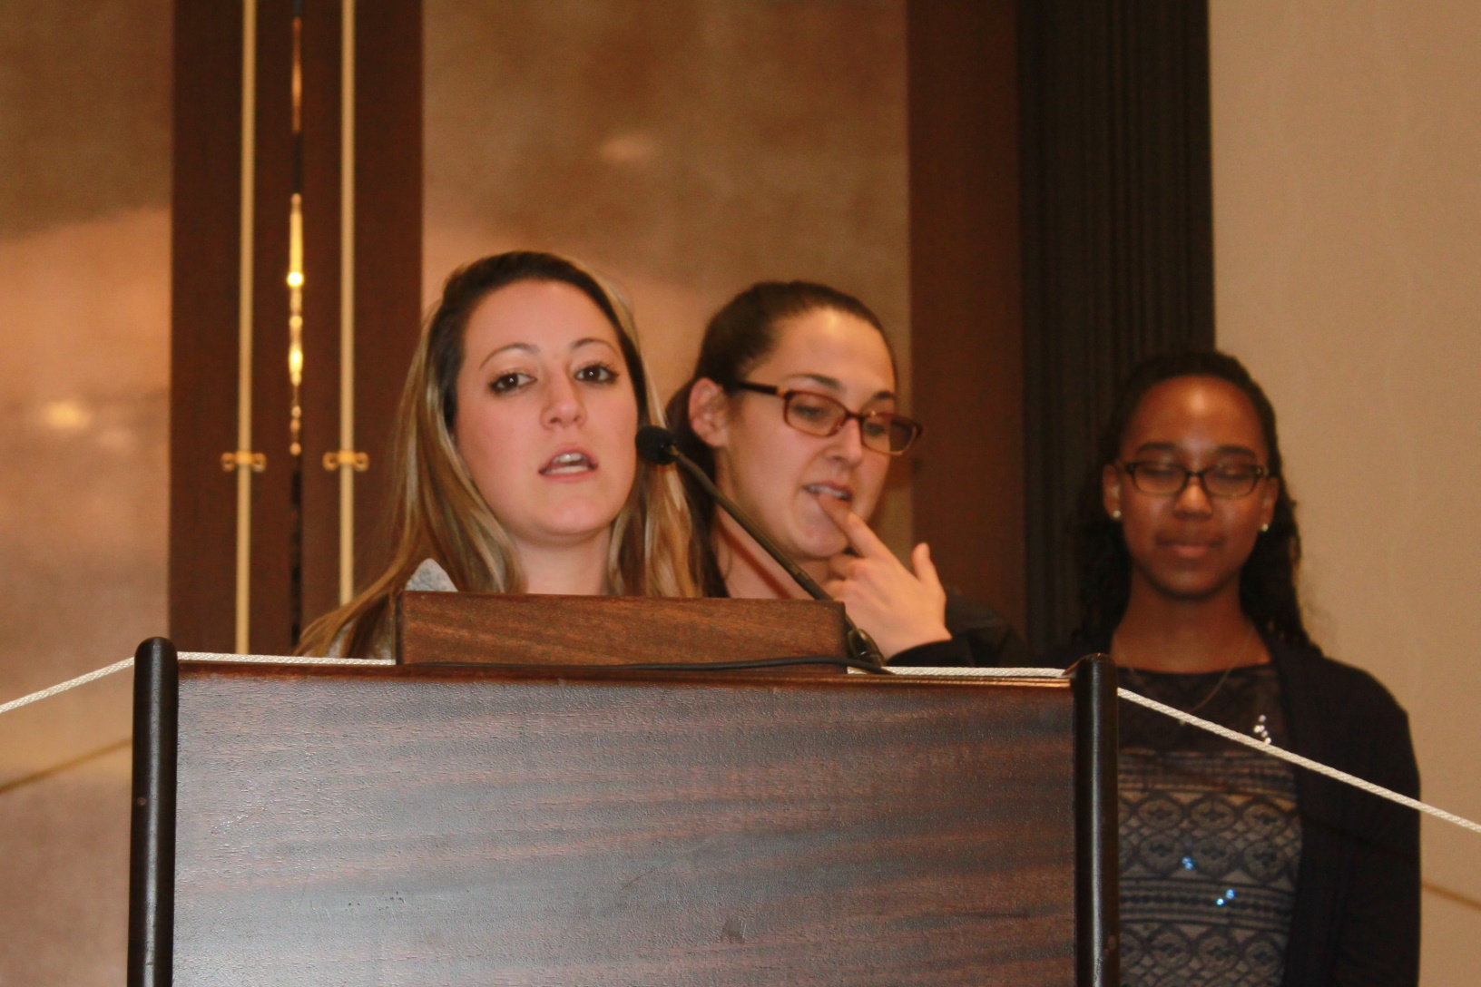
BBSU
February 2018

Slide 6
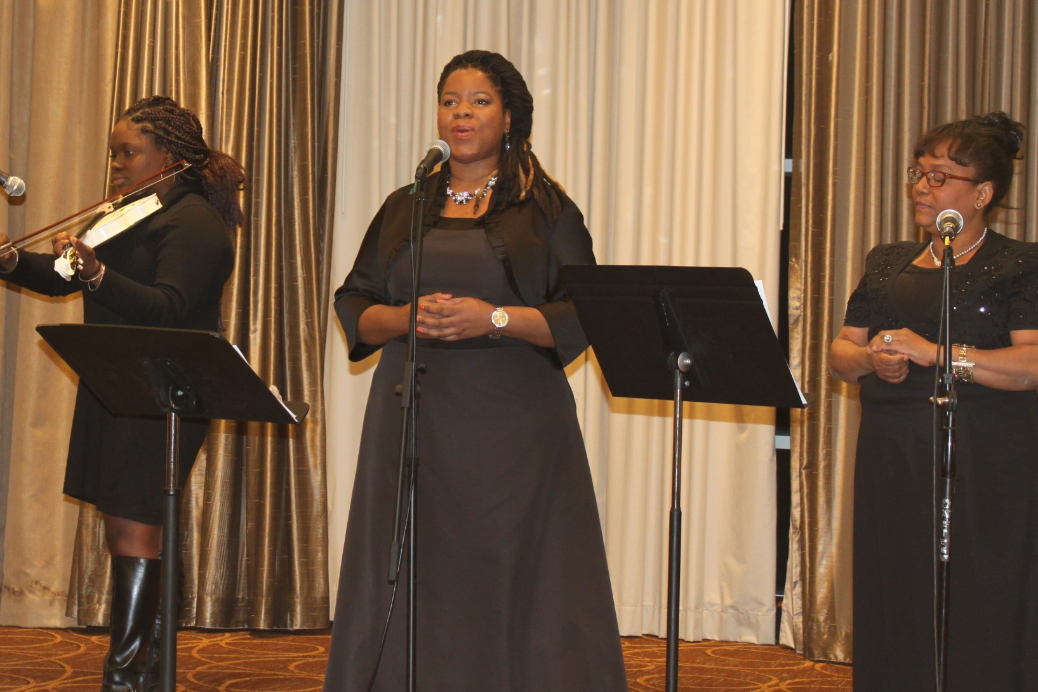
BBSU
February 2018

Slide 7
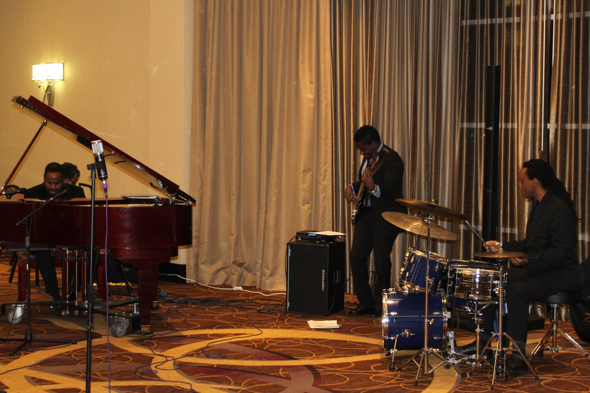
BBSU
February 2017

Slide 8
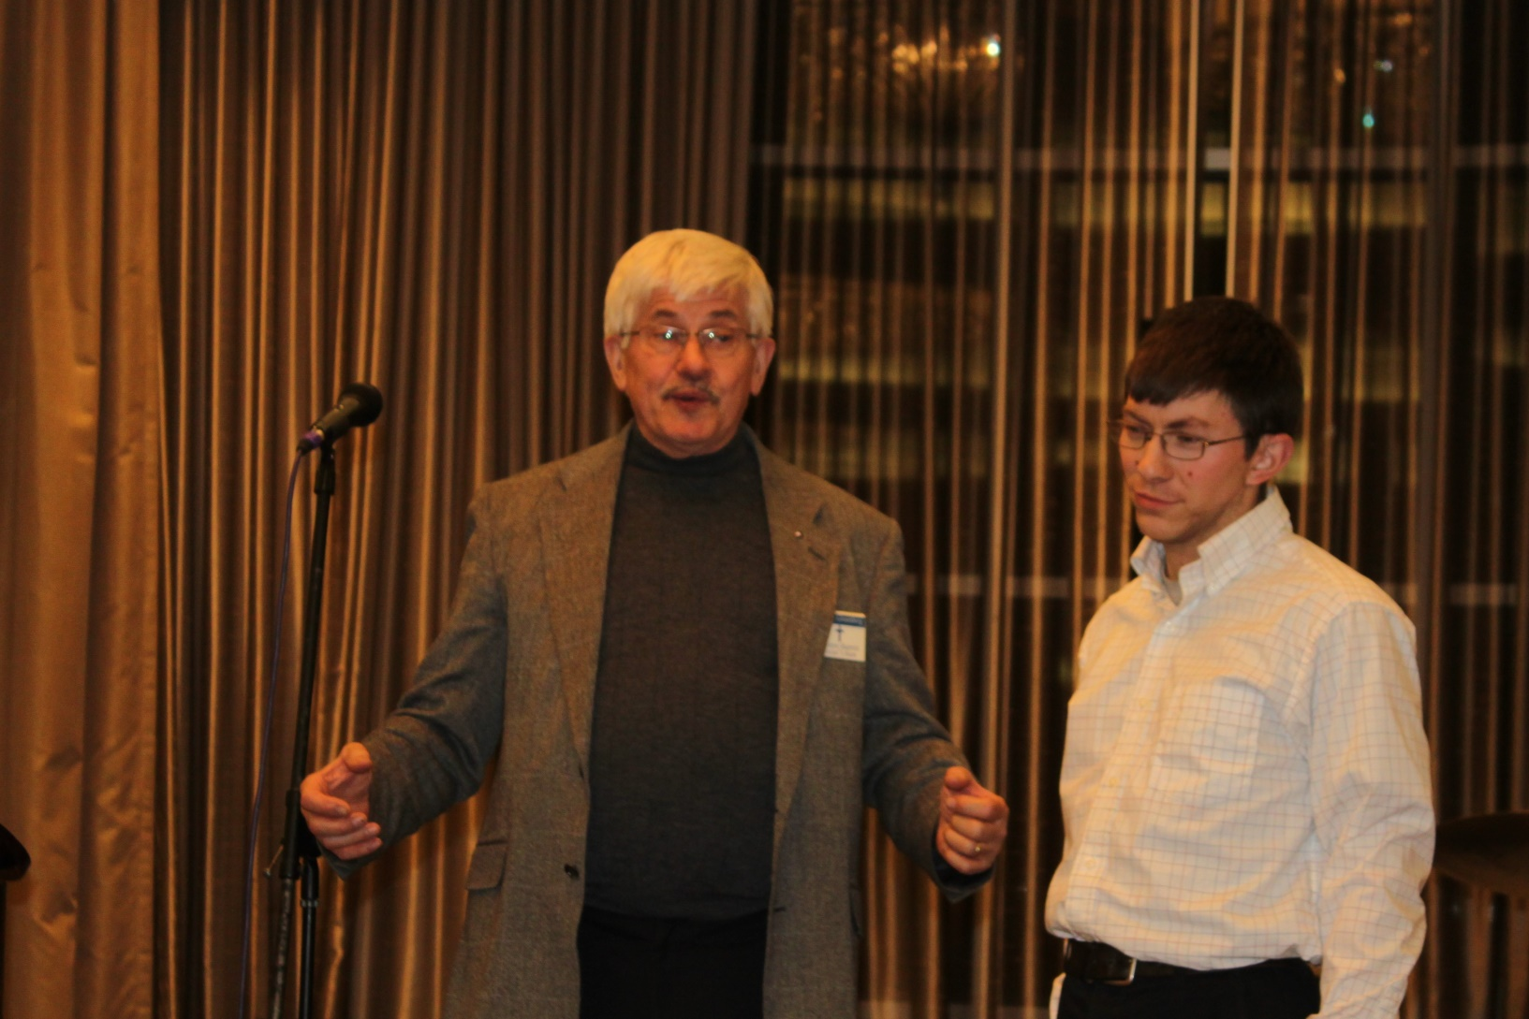
BBSU
February 2017

Slide 9
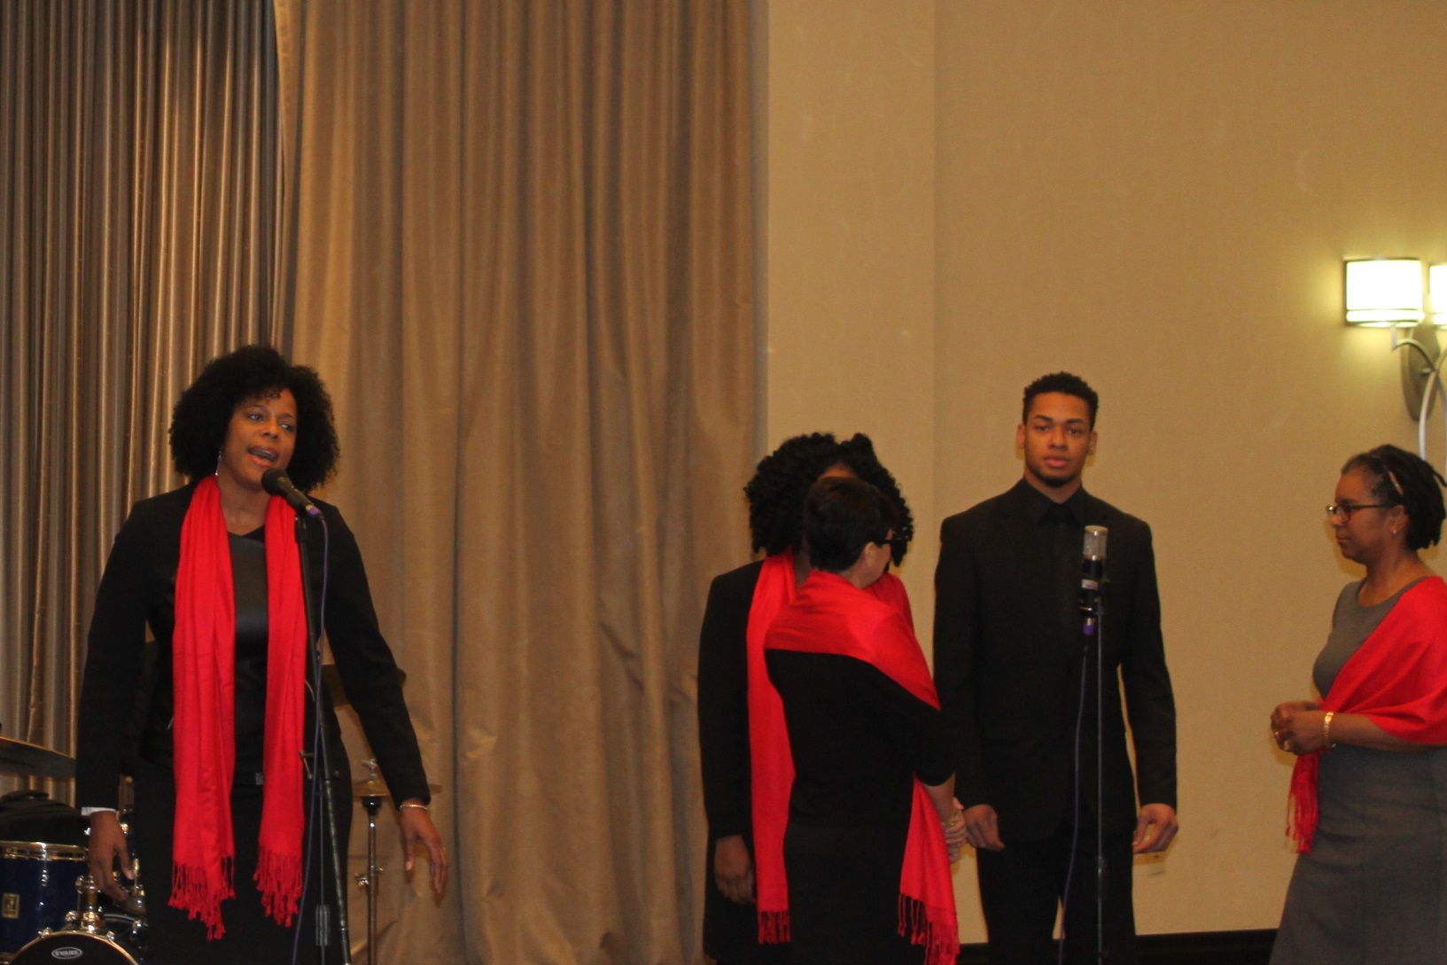
BBSU
February 2017

Slide 10
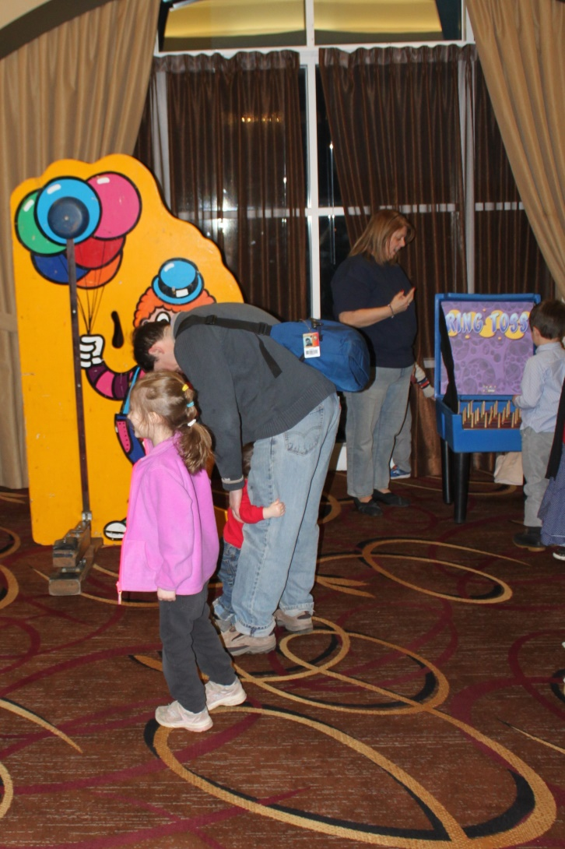
BBSU
March 2017

Slide 11
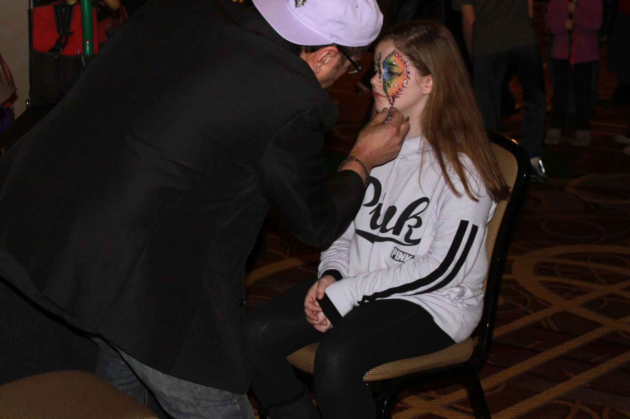
BBSU
March 2017

Slide 12
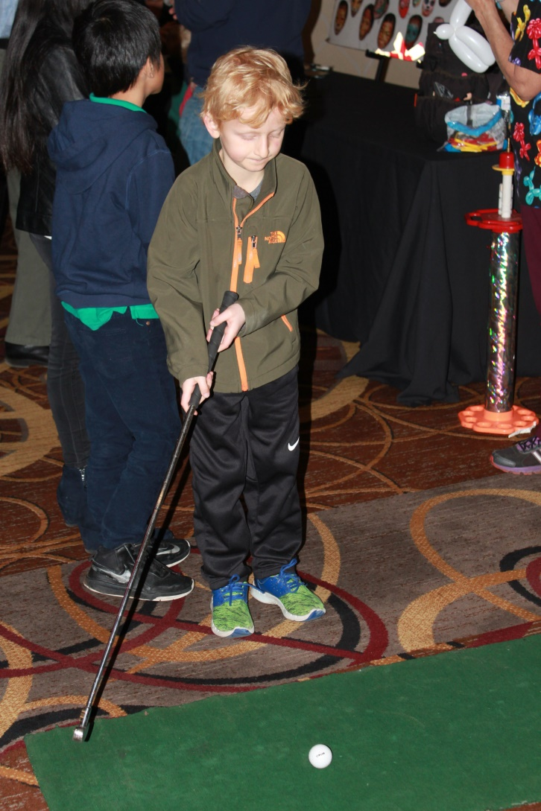
BBSU
March 2017

Slide 13
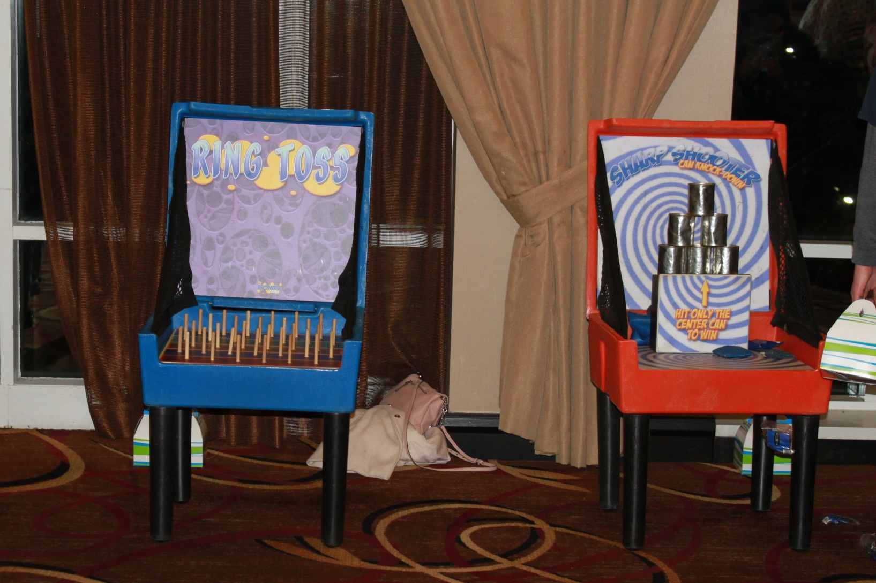
BBSU
March 2017

Slide 14
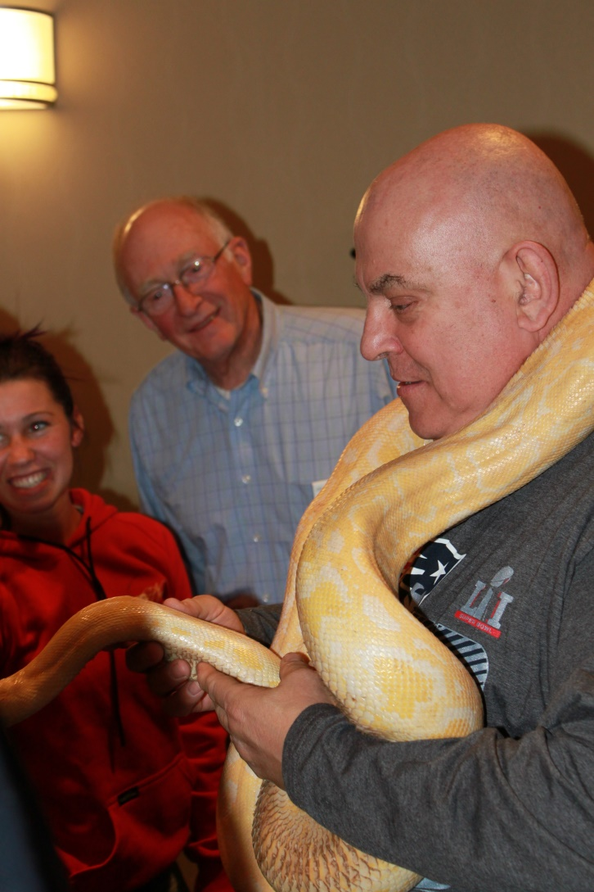
BBSU
March 2017

Slide 15
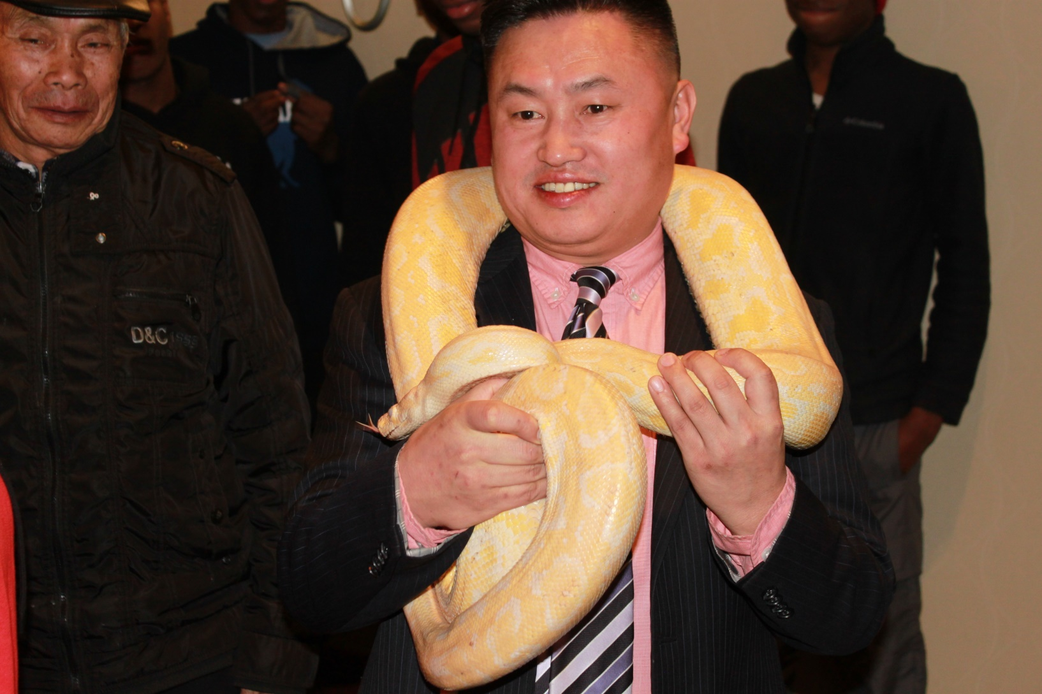
BBSU
March 2017

Slide 16
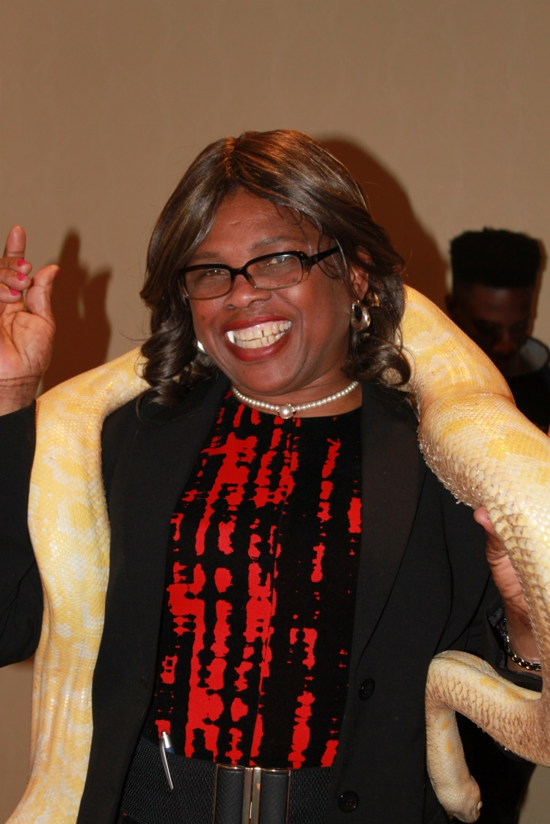
BBSU
March 2017

Slide 17
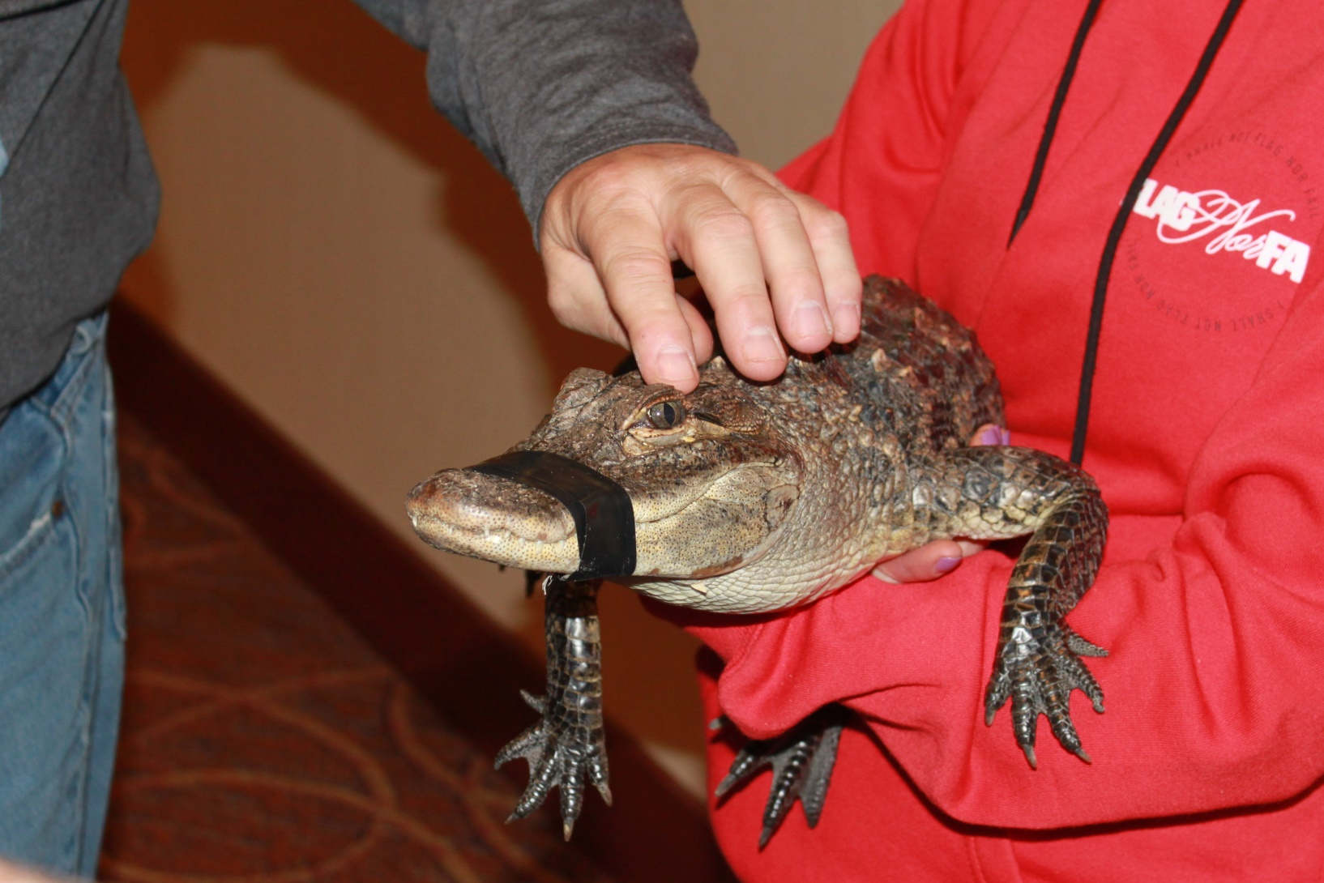
BBSU
March 2017

Slide 18
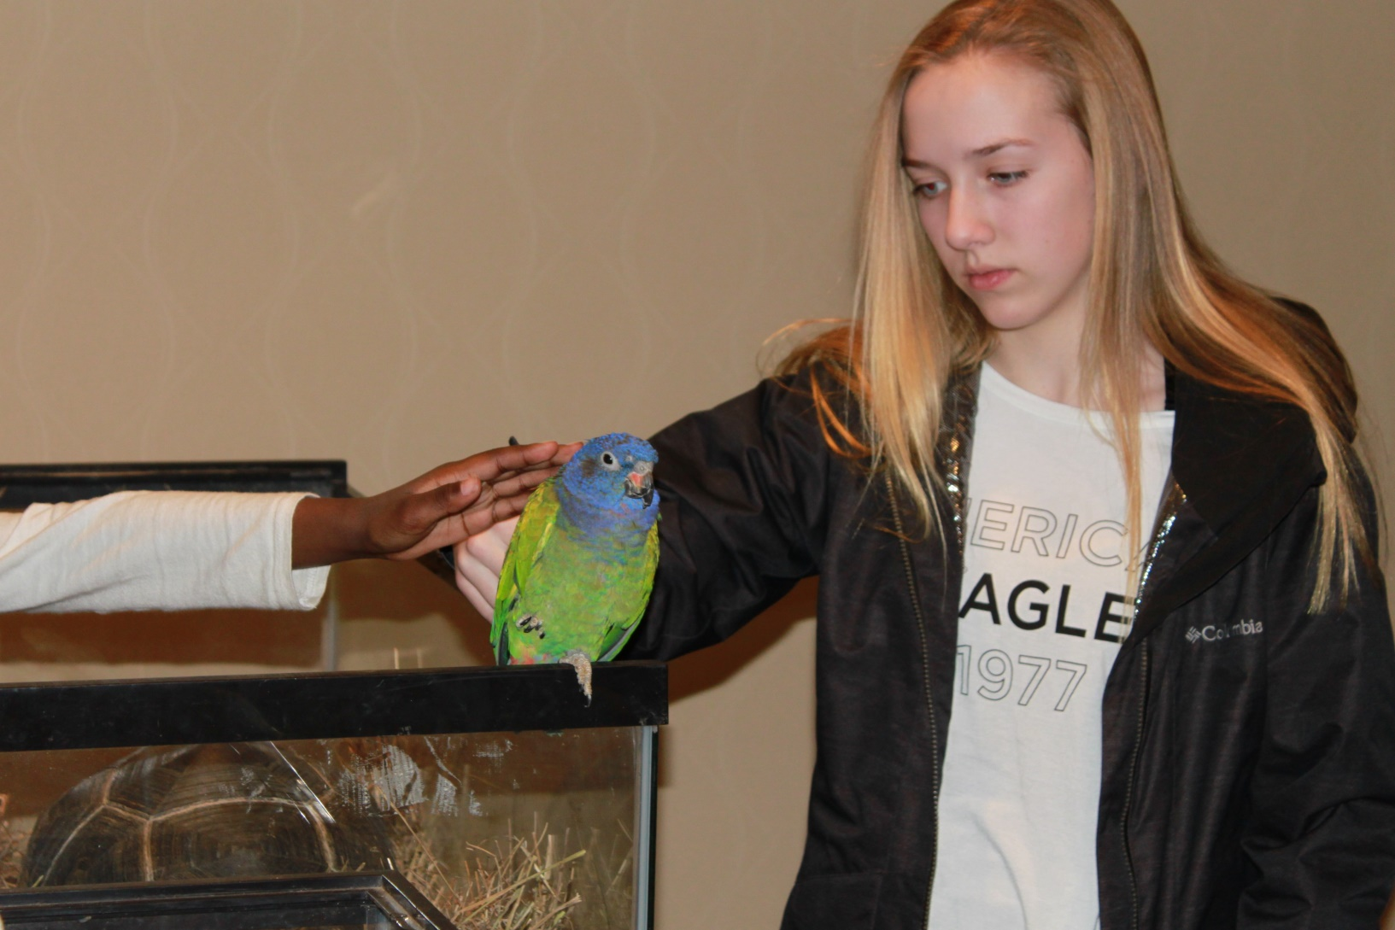
March
2017

Slide 19
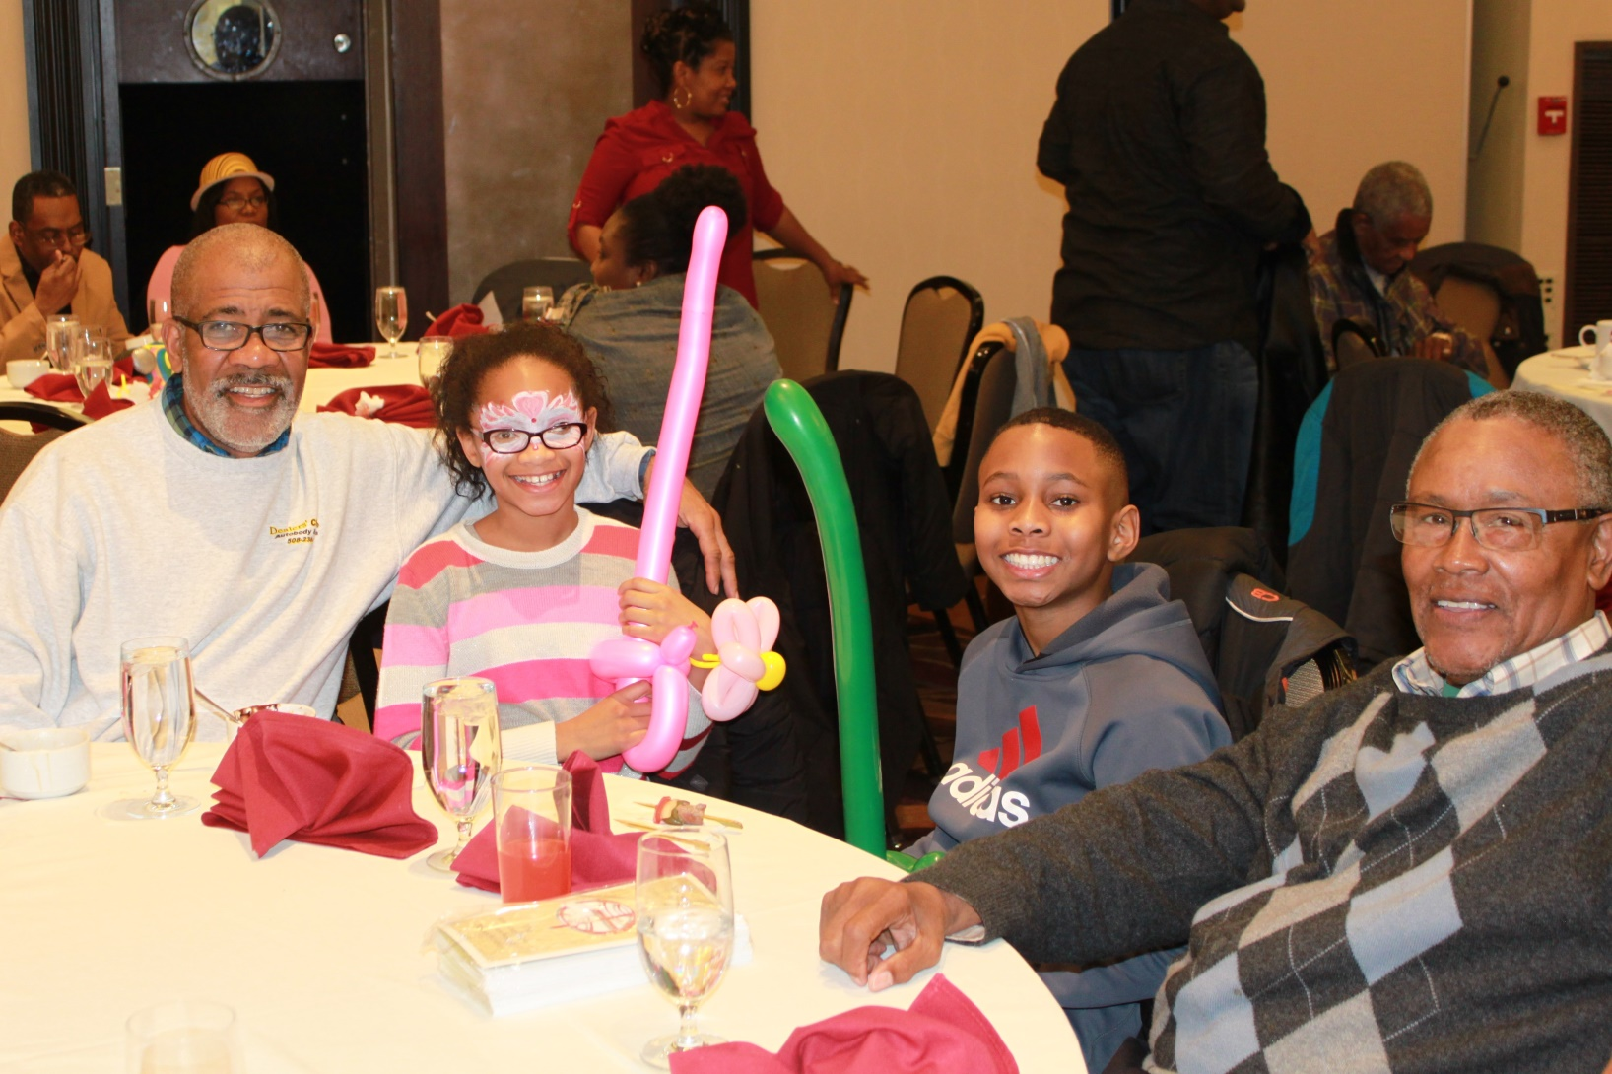
BBSU
March 2017

Slide 20
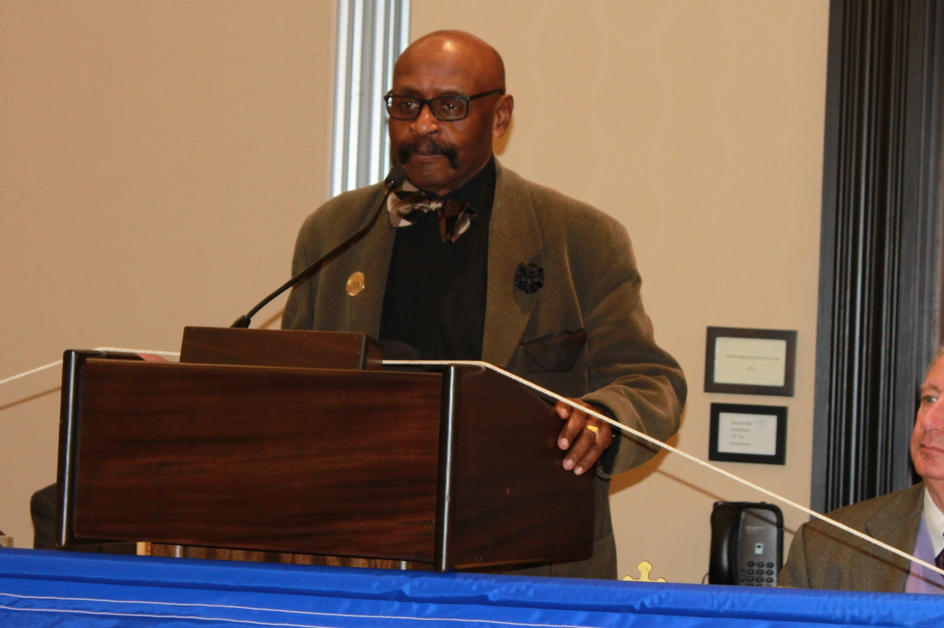
BBSU
April 2017

Slide 21
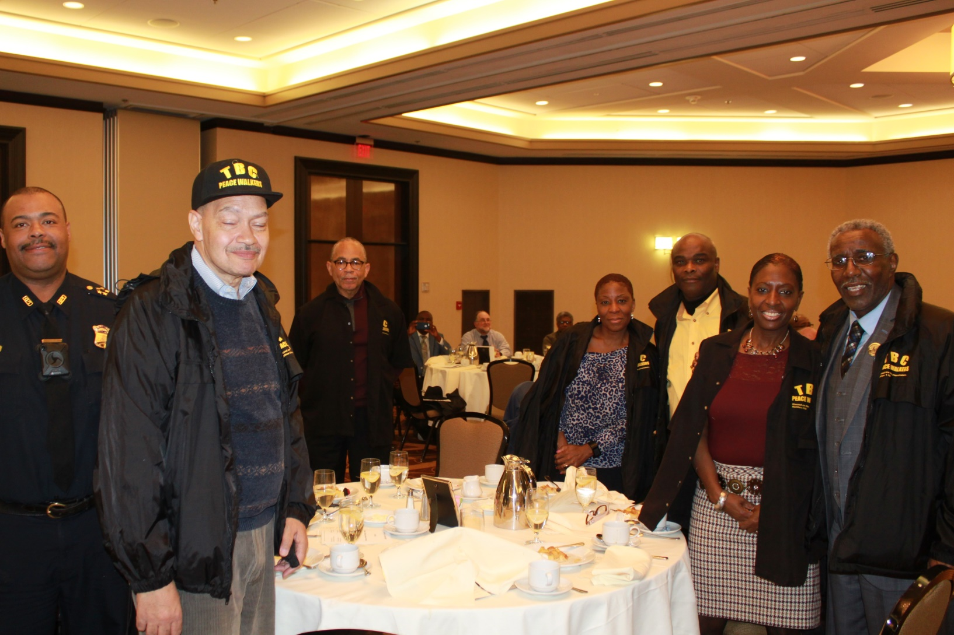
BBSU
April 2017

Slide 22
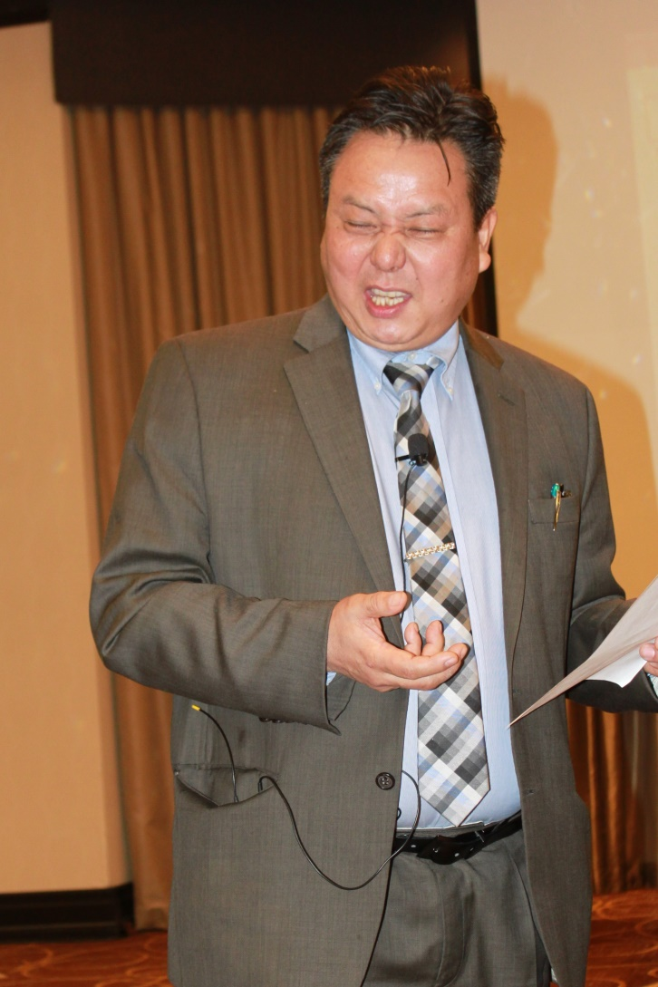
BBSU
April 2017

Slide 23
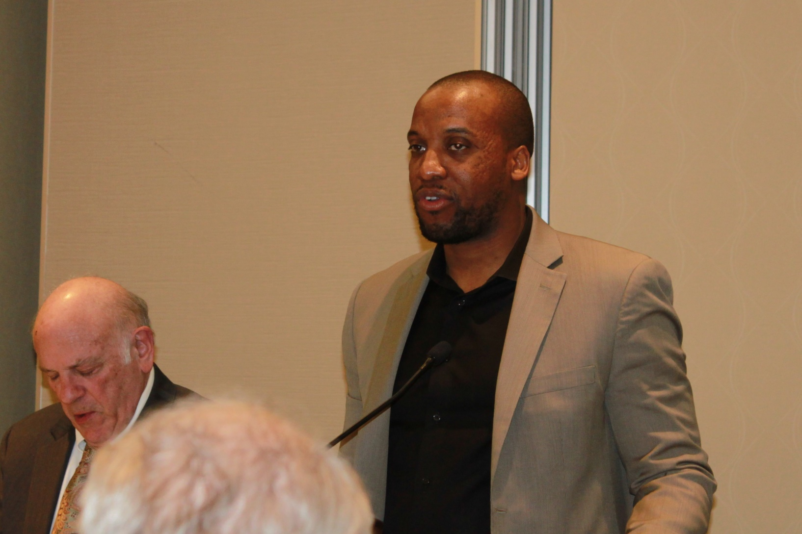
BBSU
April 2017

Slide 24
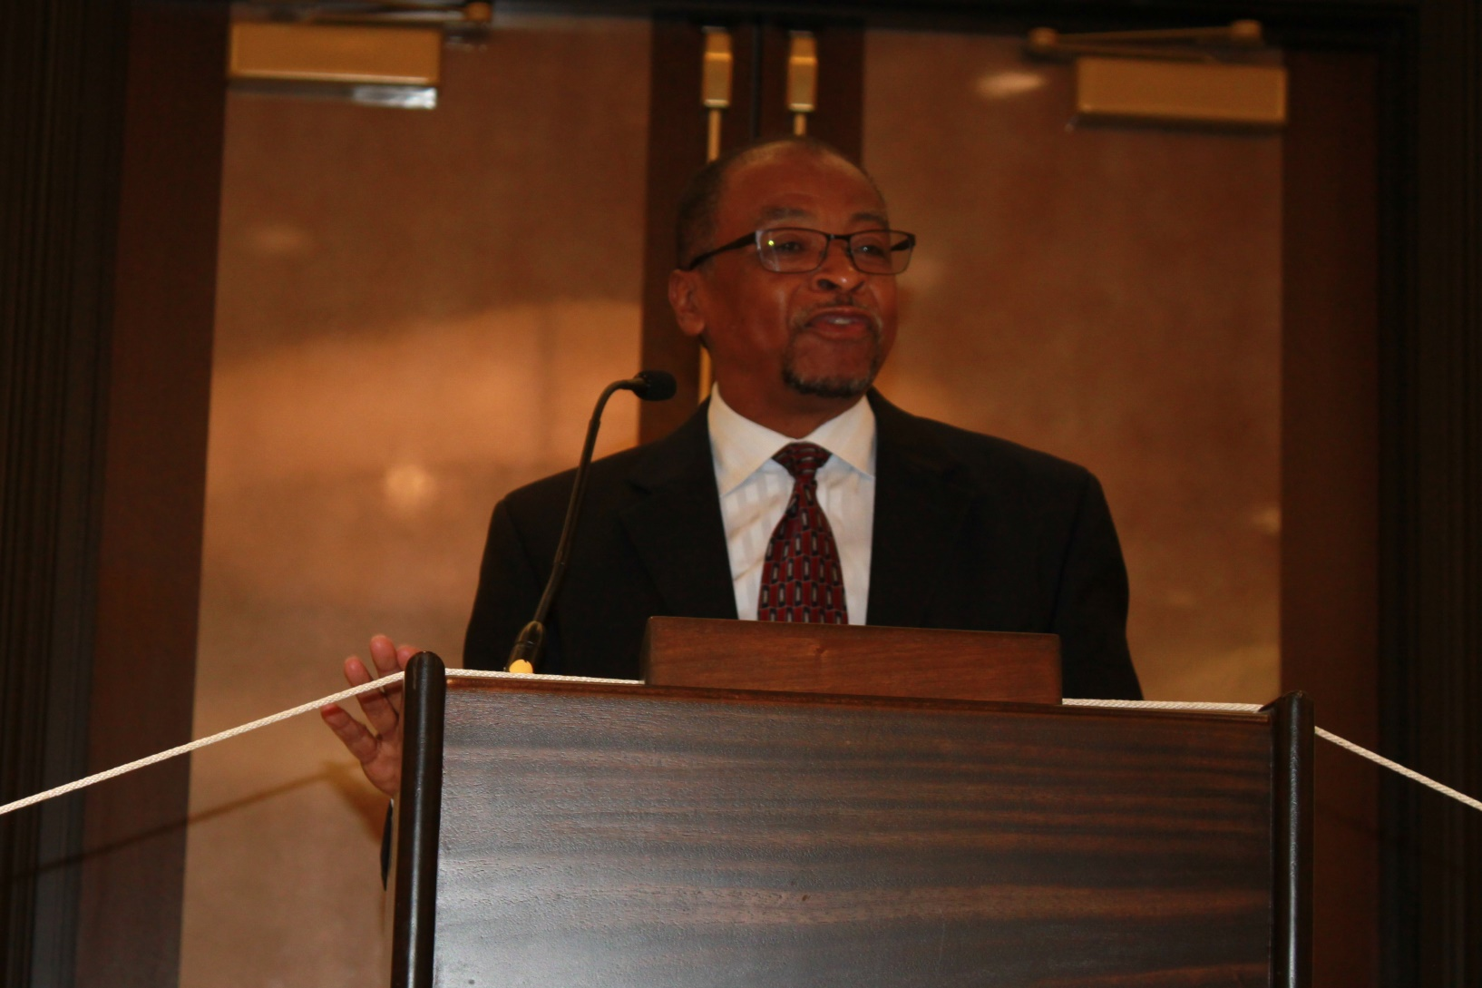
BBSU
May 2017

Slide 25
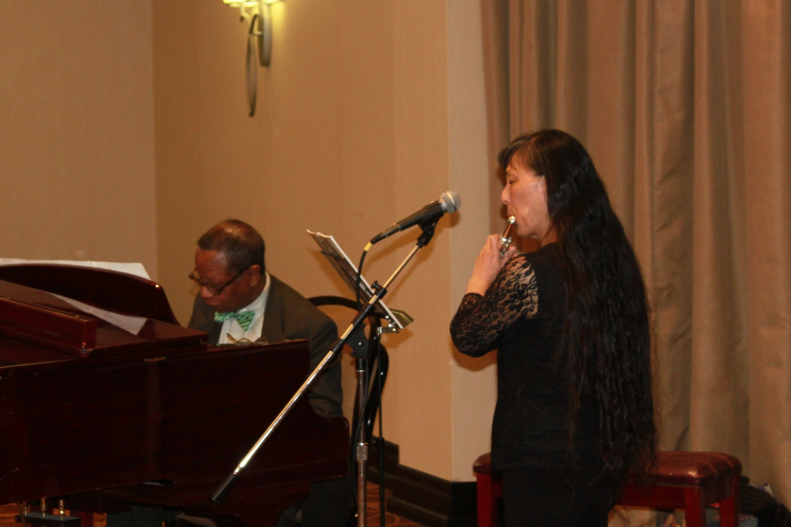
BBSU
May 2017

Slide 26
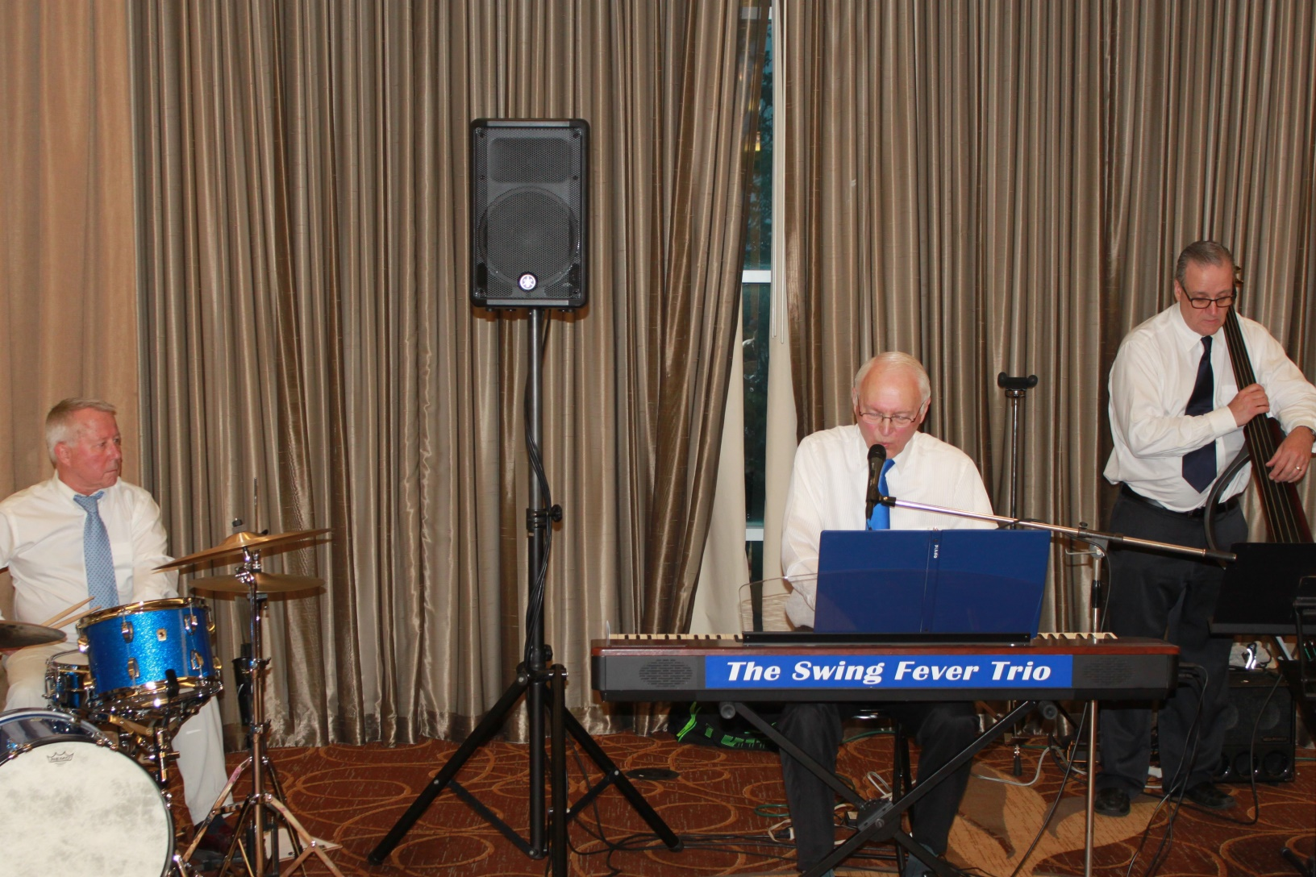
BBSU
June 2017

Slide 27
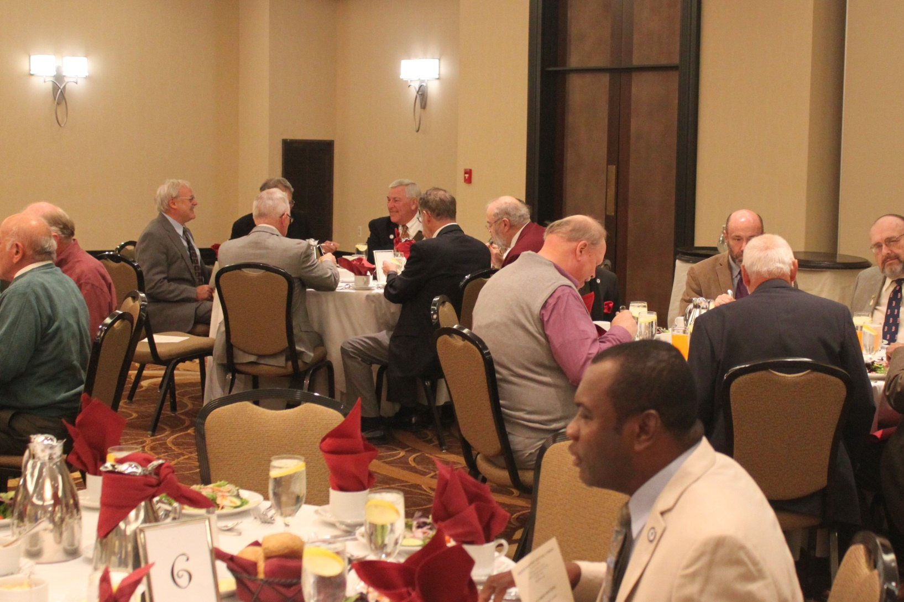
BBSU
October 2017

Slide 28
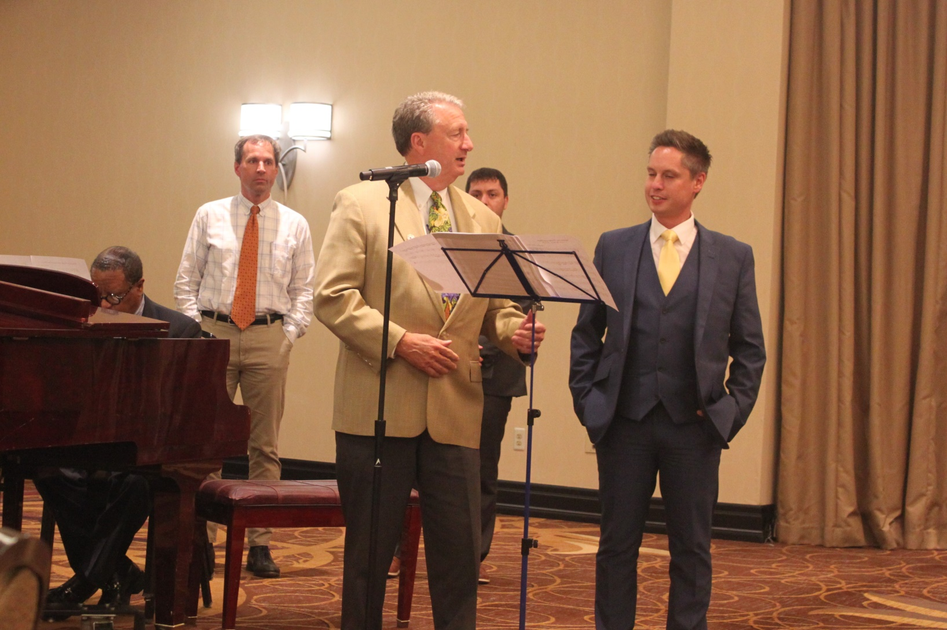
BBSU
October 2017

Slide 29
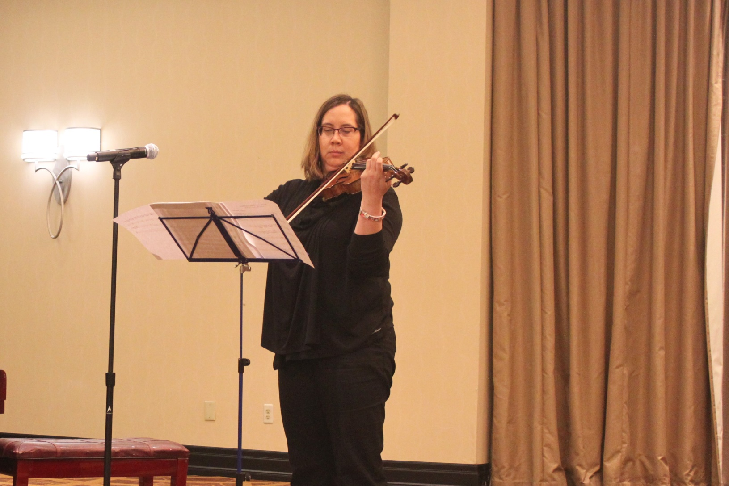
BBSU
October 2017

Slide 30
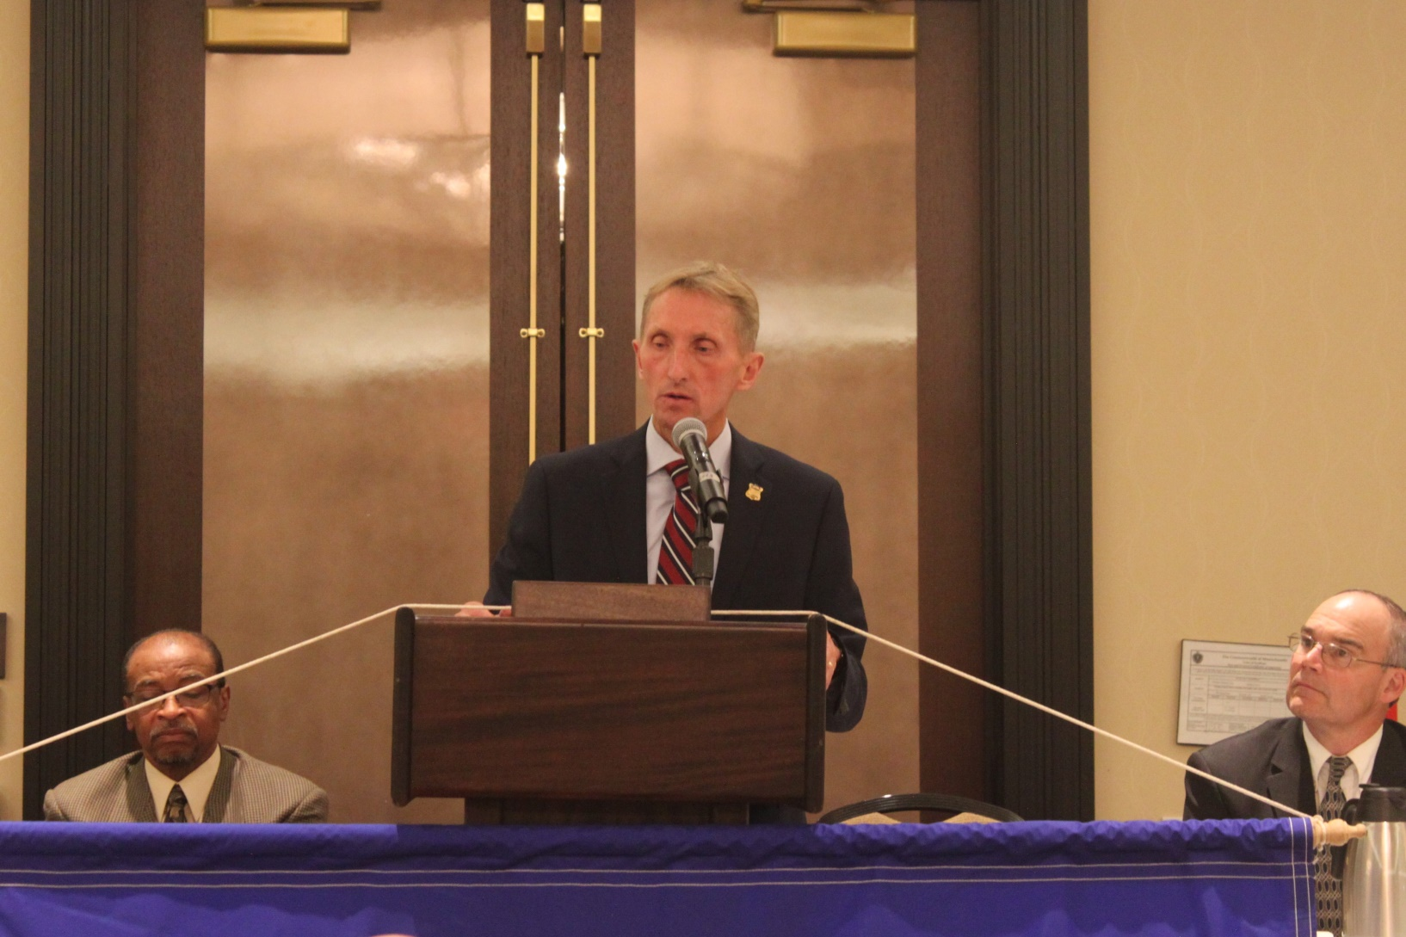
BBSU
October 2017

Slide 31
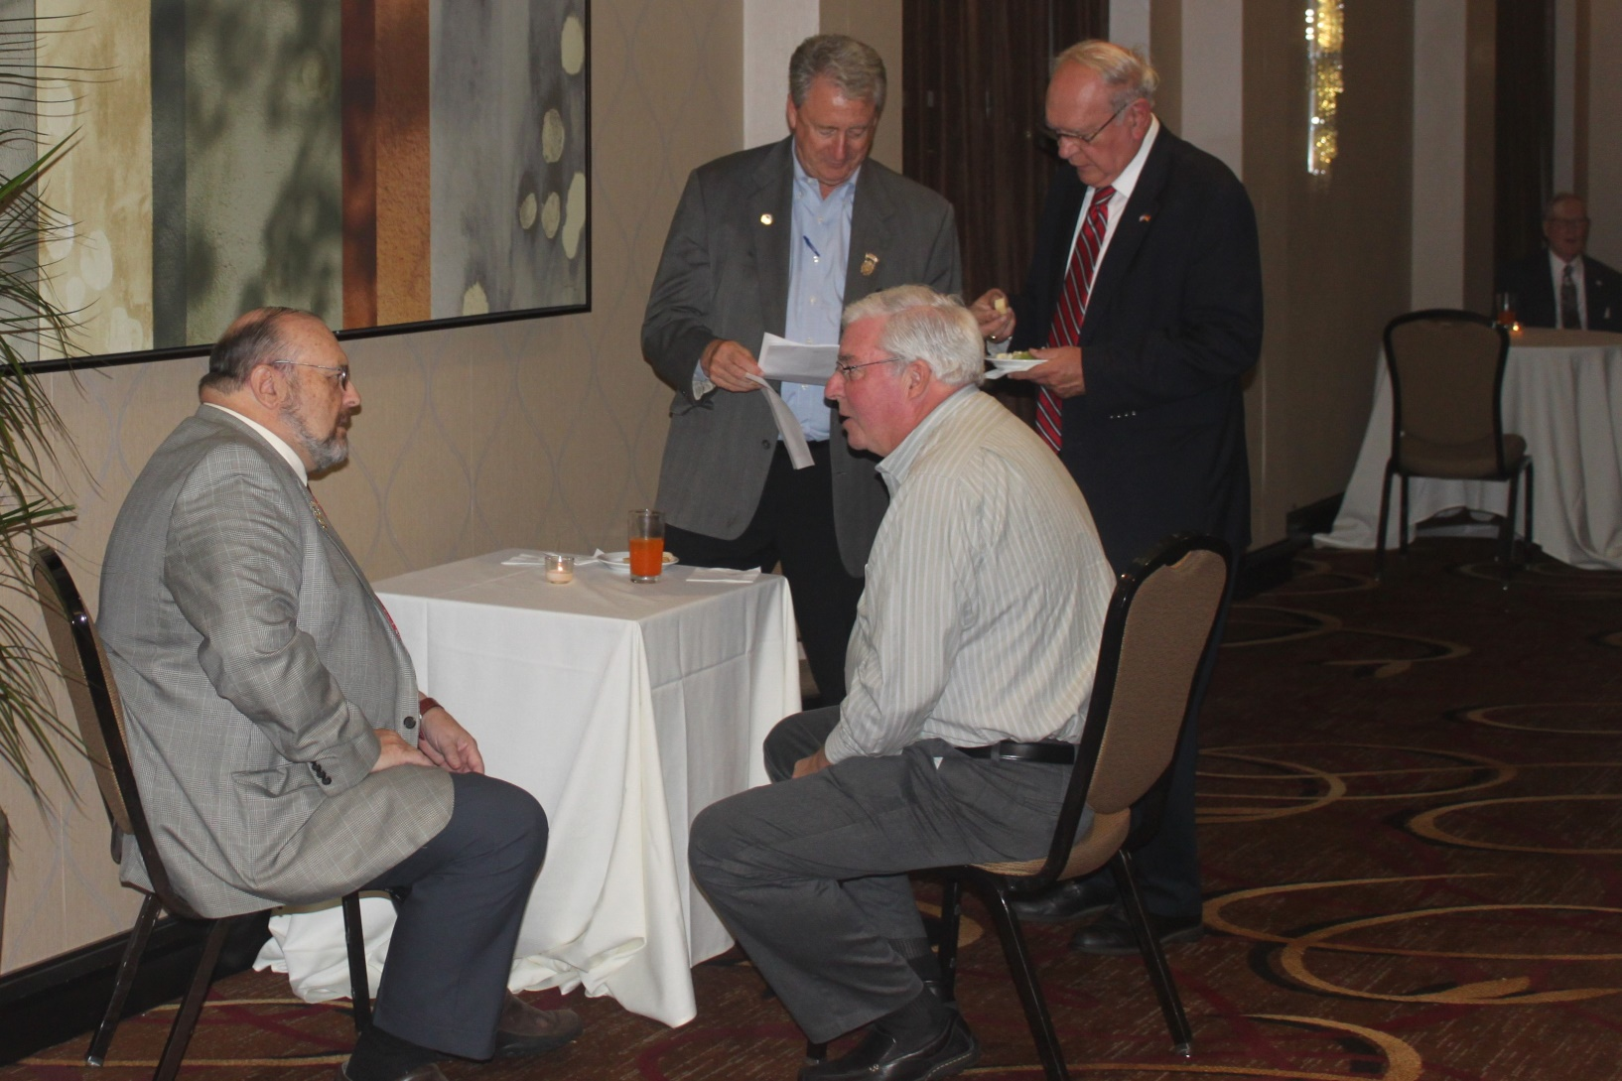
BBSU
November 2017

Slide 32
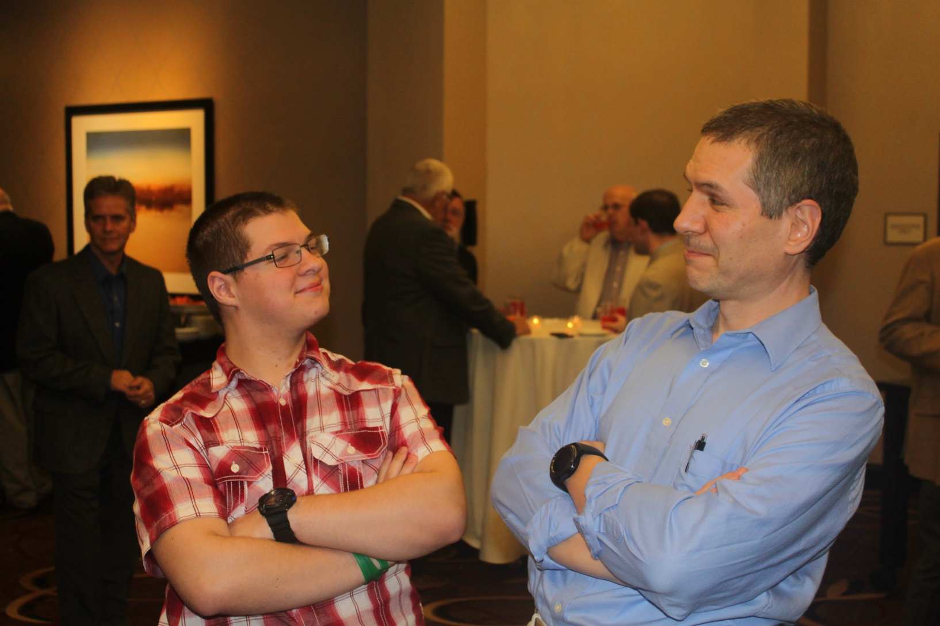
BBSU
November 2017

Slide 33
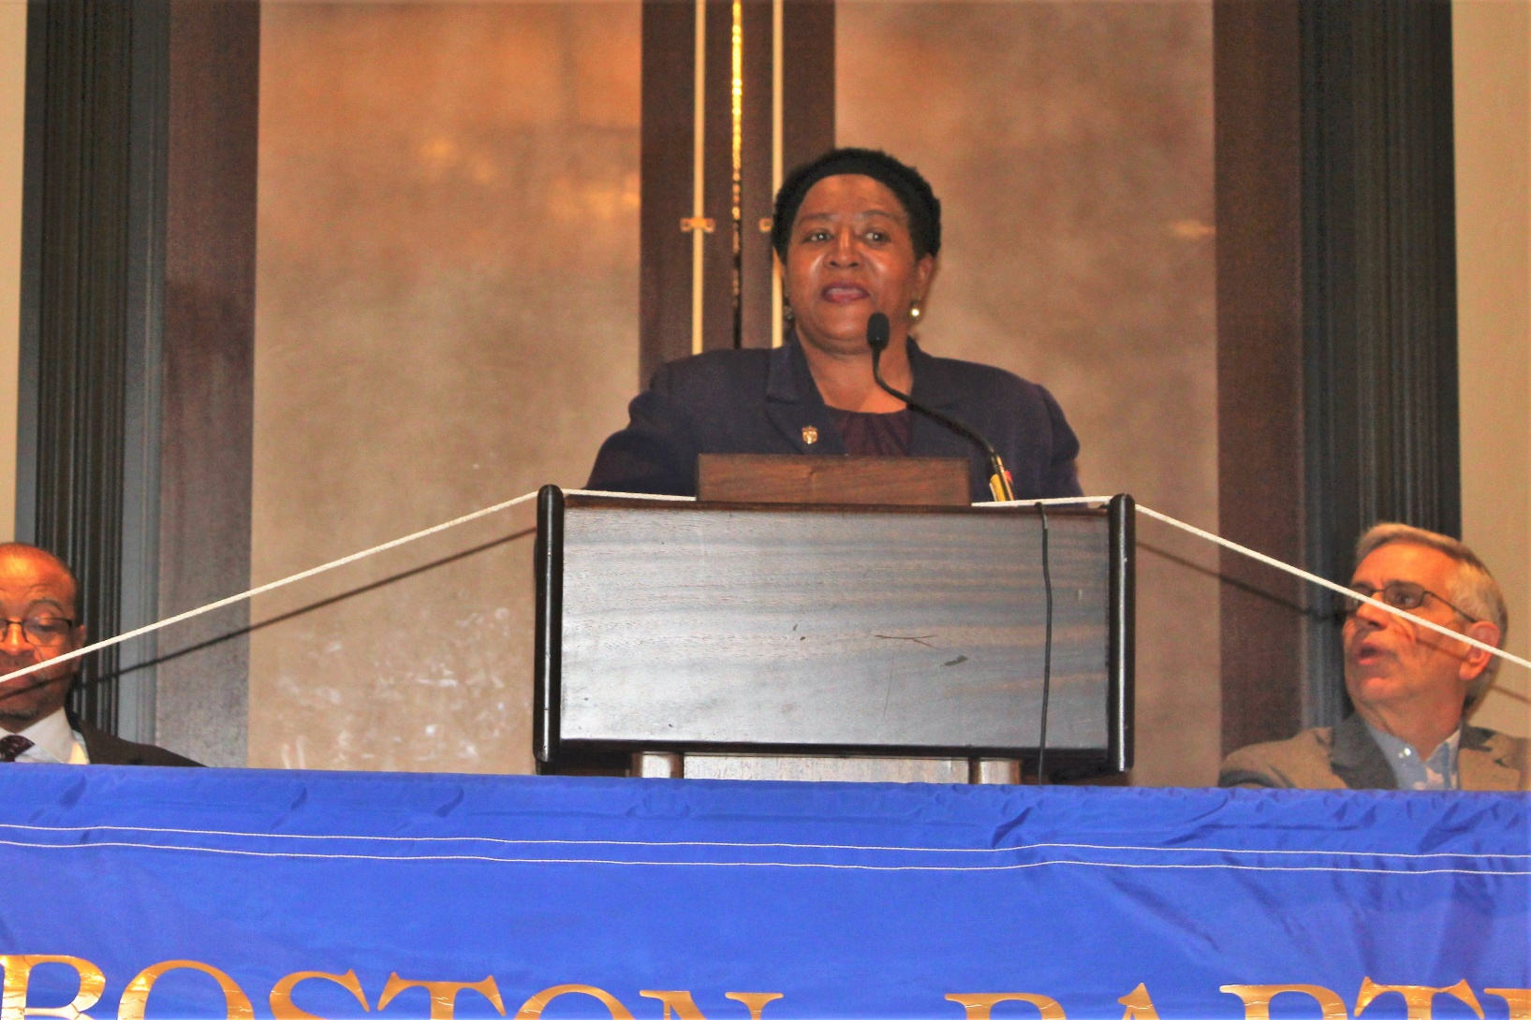
BBSU
November 2017

Slide 34
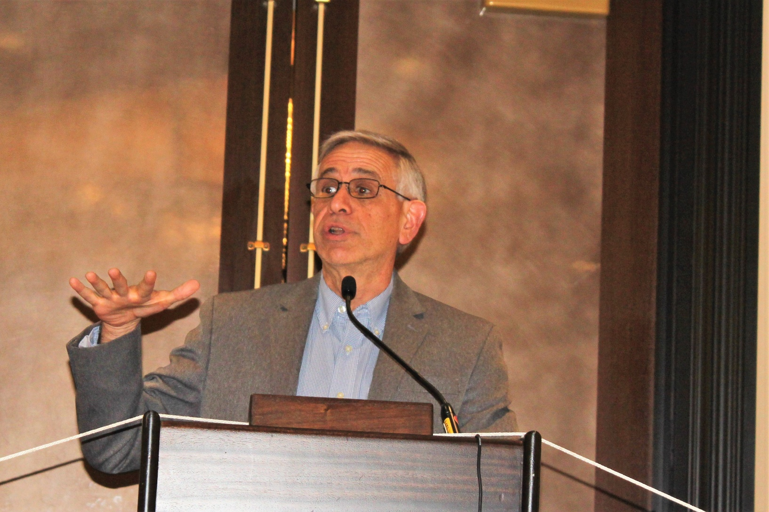
BBSU
November 2017

Slide 35
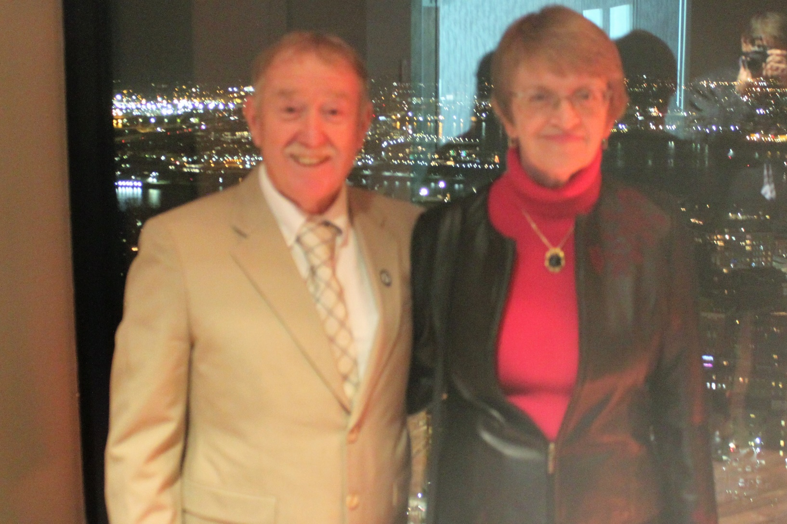
BBSU
December 2017

Slide 36
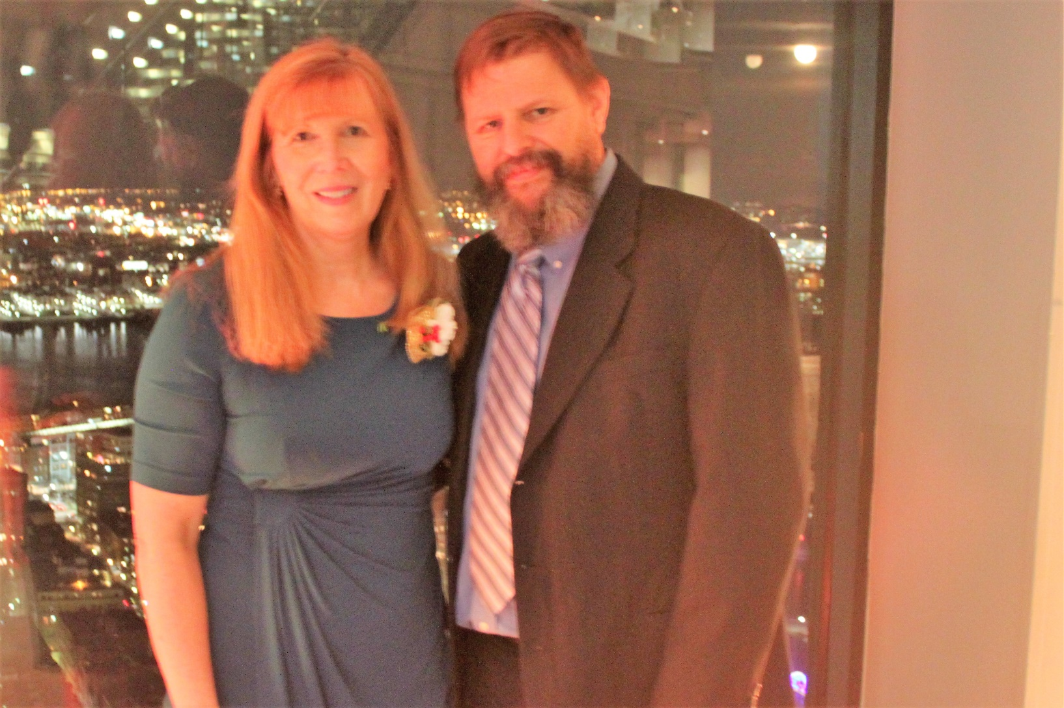
BBSU
December 2017

Slide 37

BBSU
December 2017

Slide 38
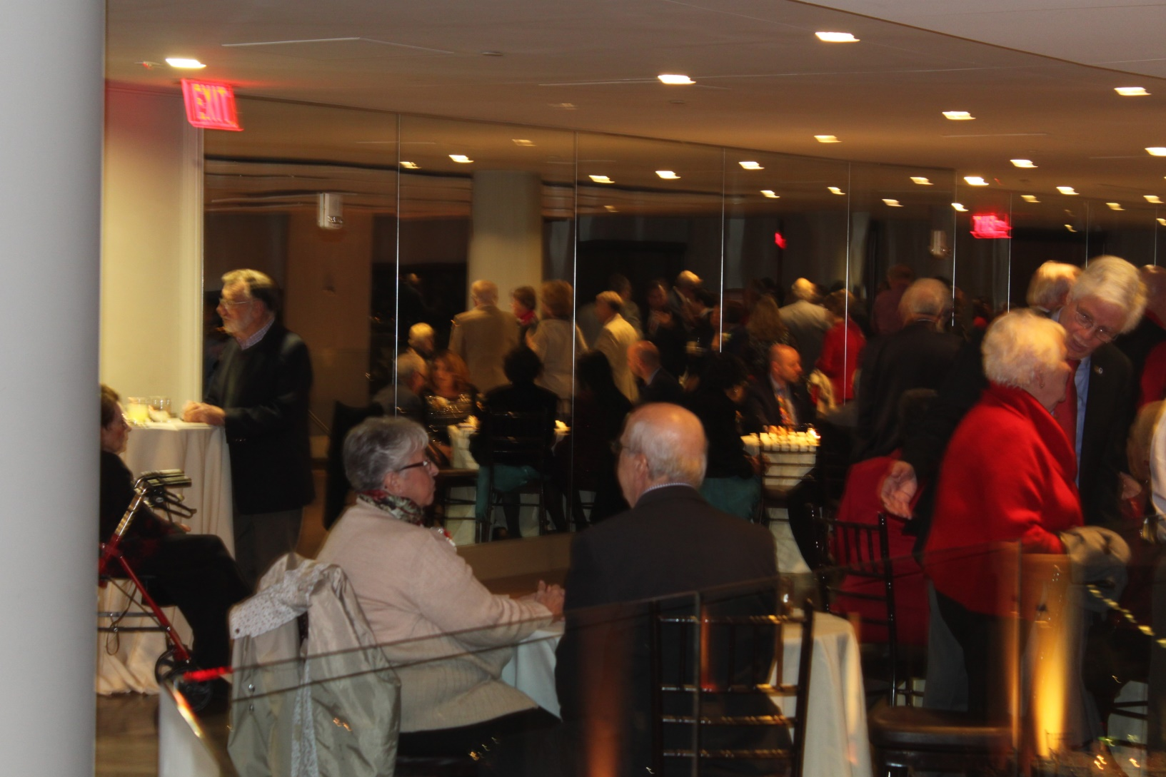
BBSU
December 2017

Slide 39
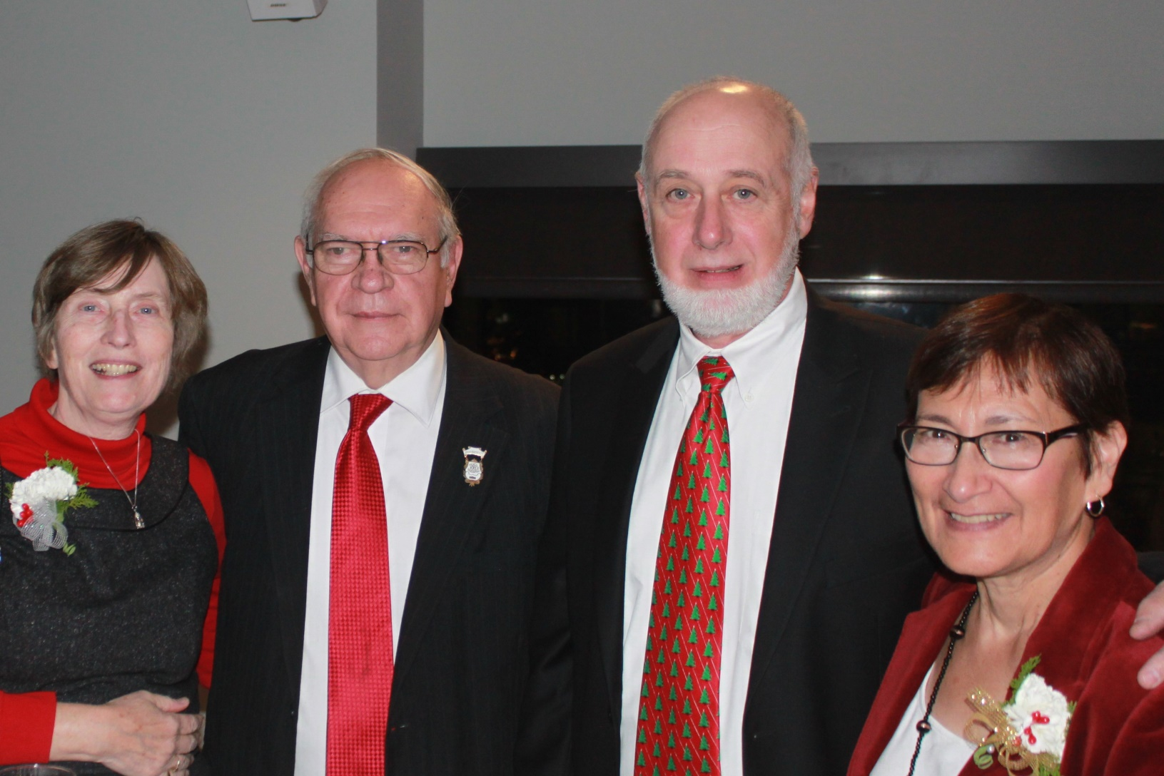
BBSU
December 2017

Slide 40
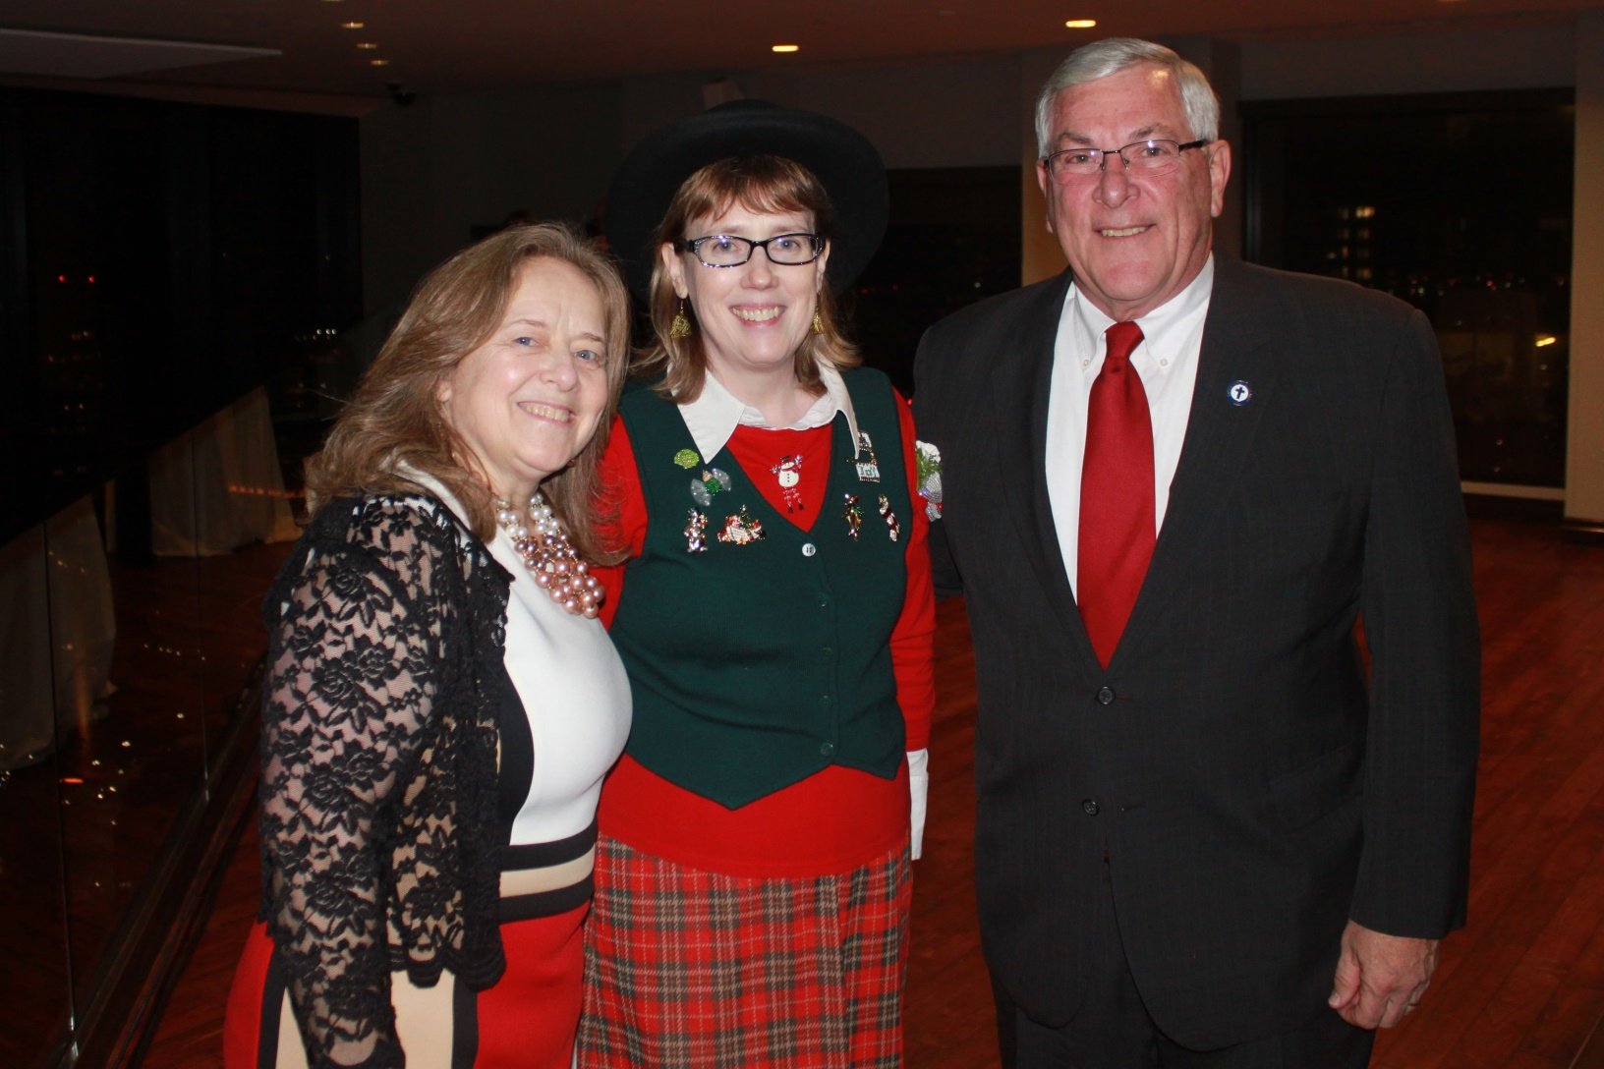
BBSU
December 2017

Slide 41
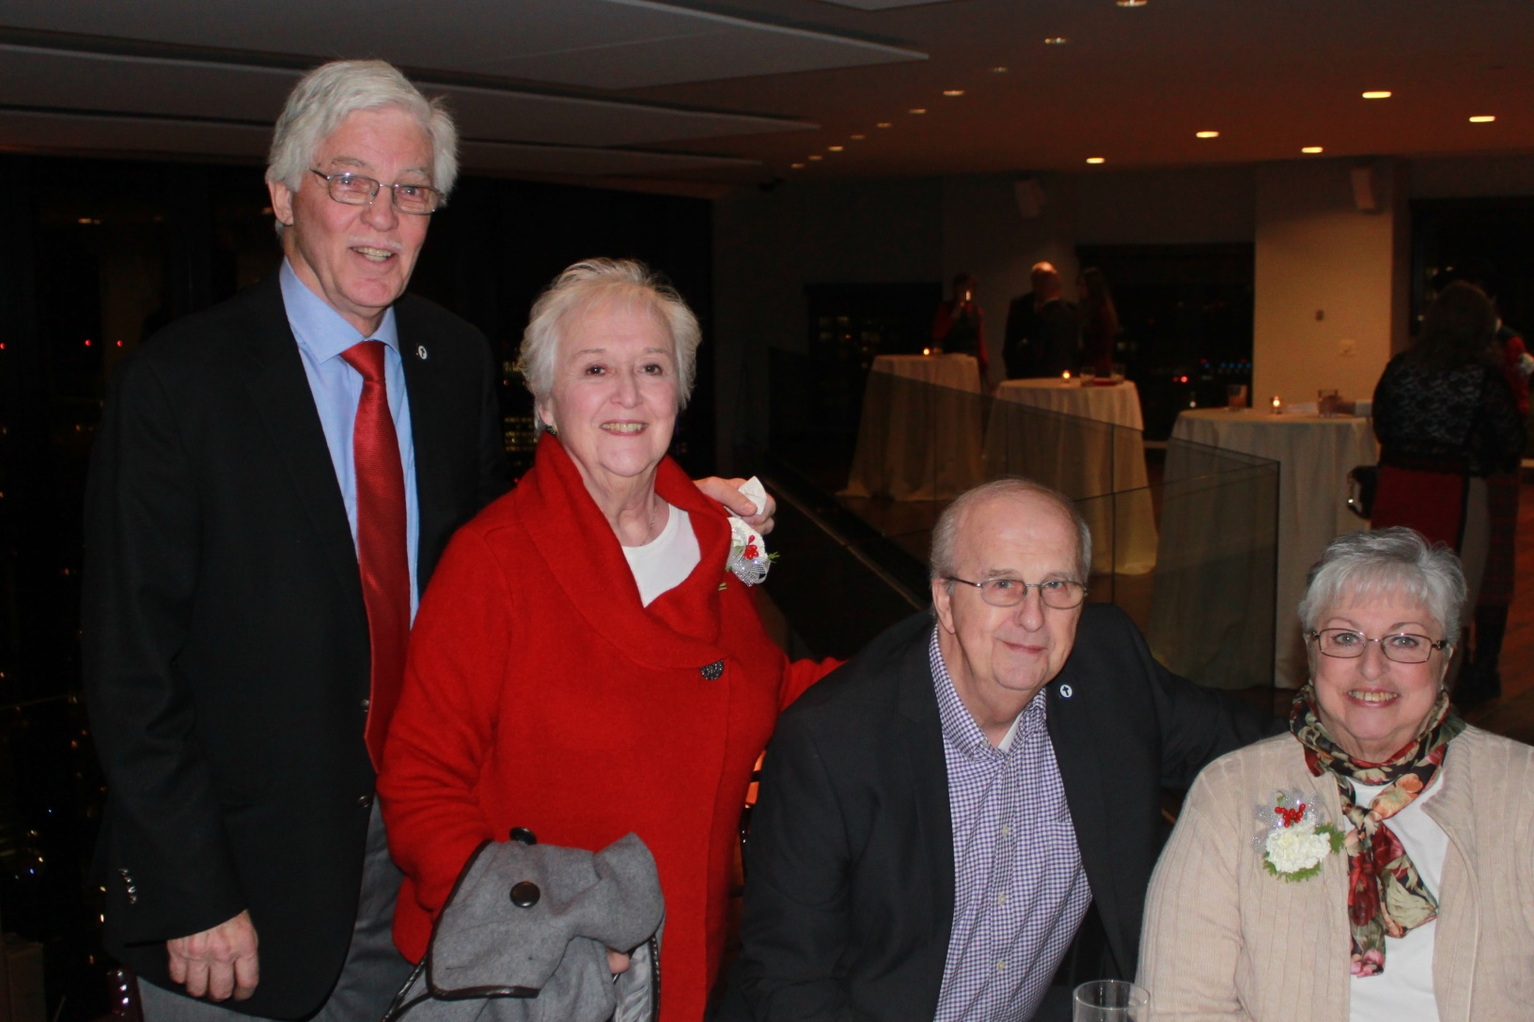
BBSU
December 2017

Slide 42
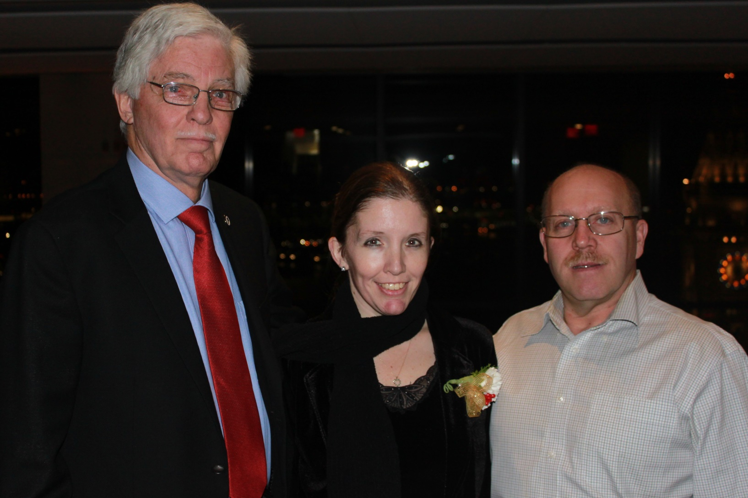
BBSU
December 2017

Slide 43
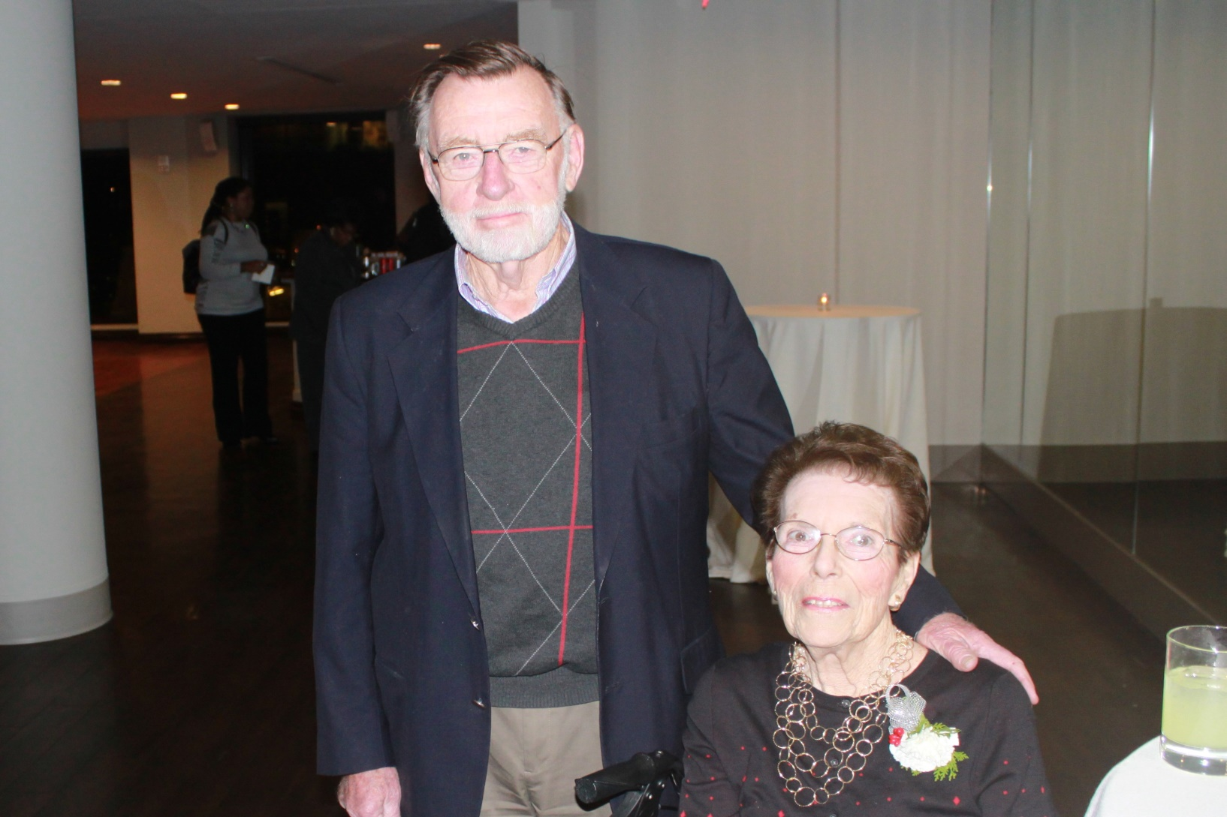
BBSU
December 2017

Slide 44
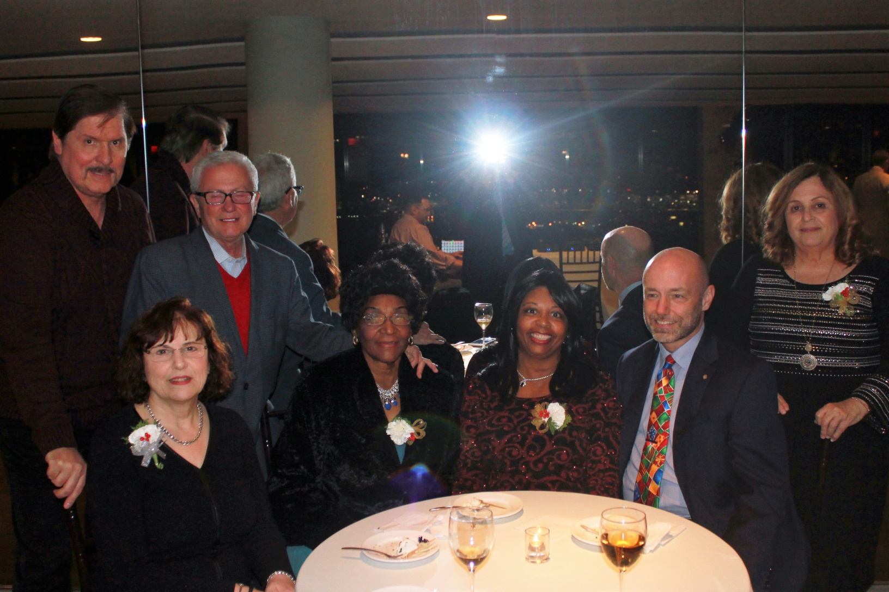
BBSU
December 2017

Slide 45
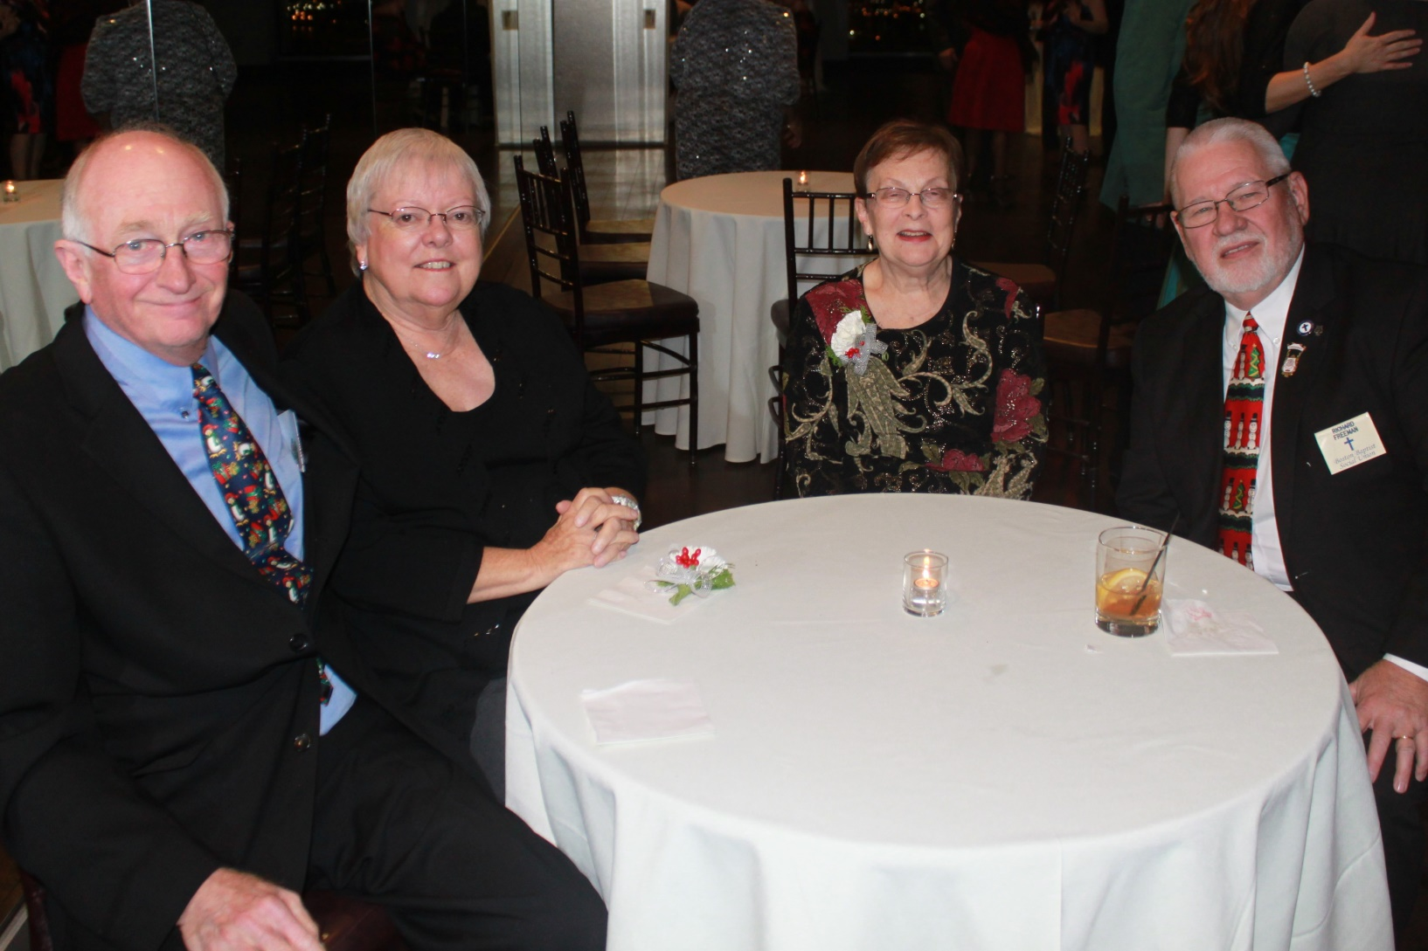
BBSU
December 2017

Slide 46
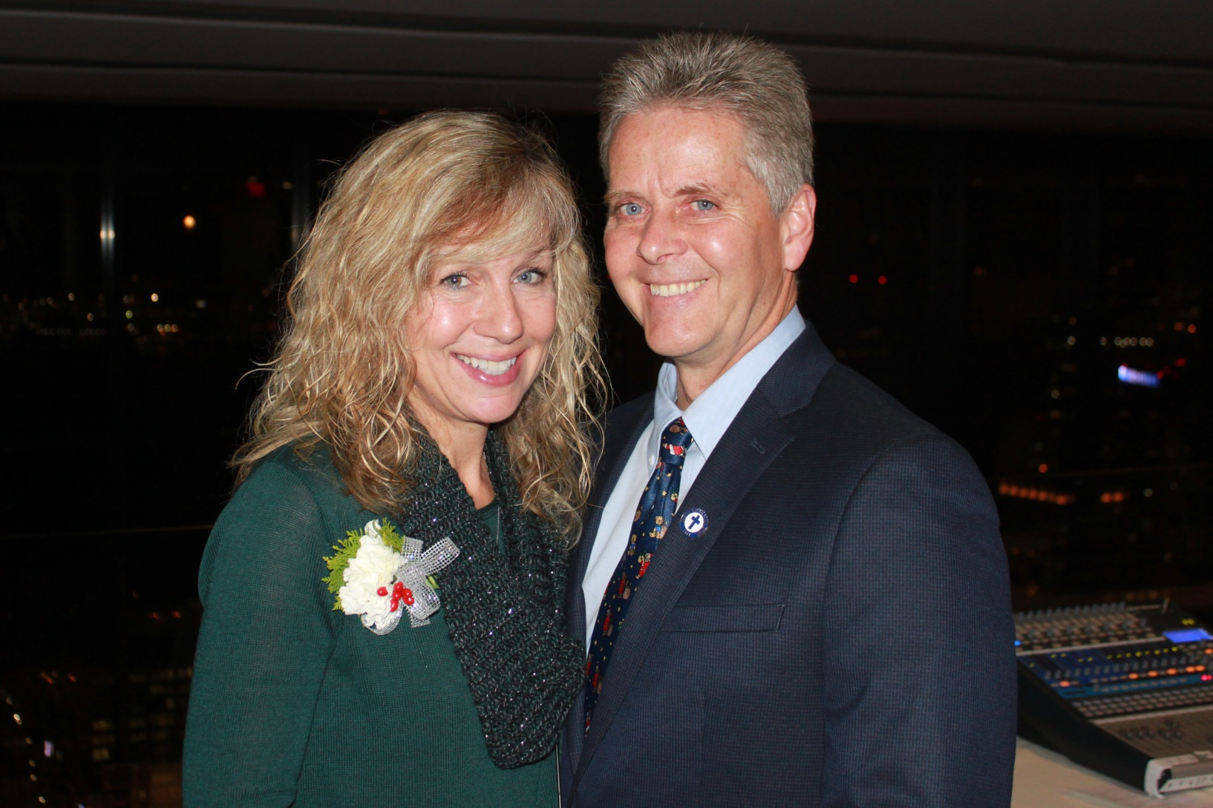
BBSU
December 2017

Slide 47
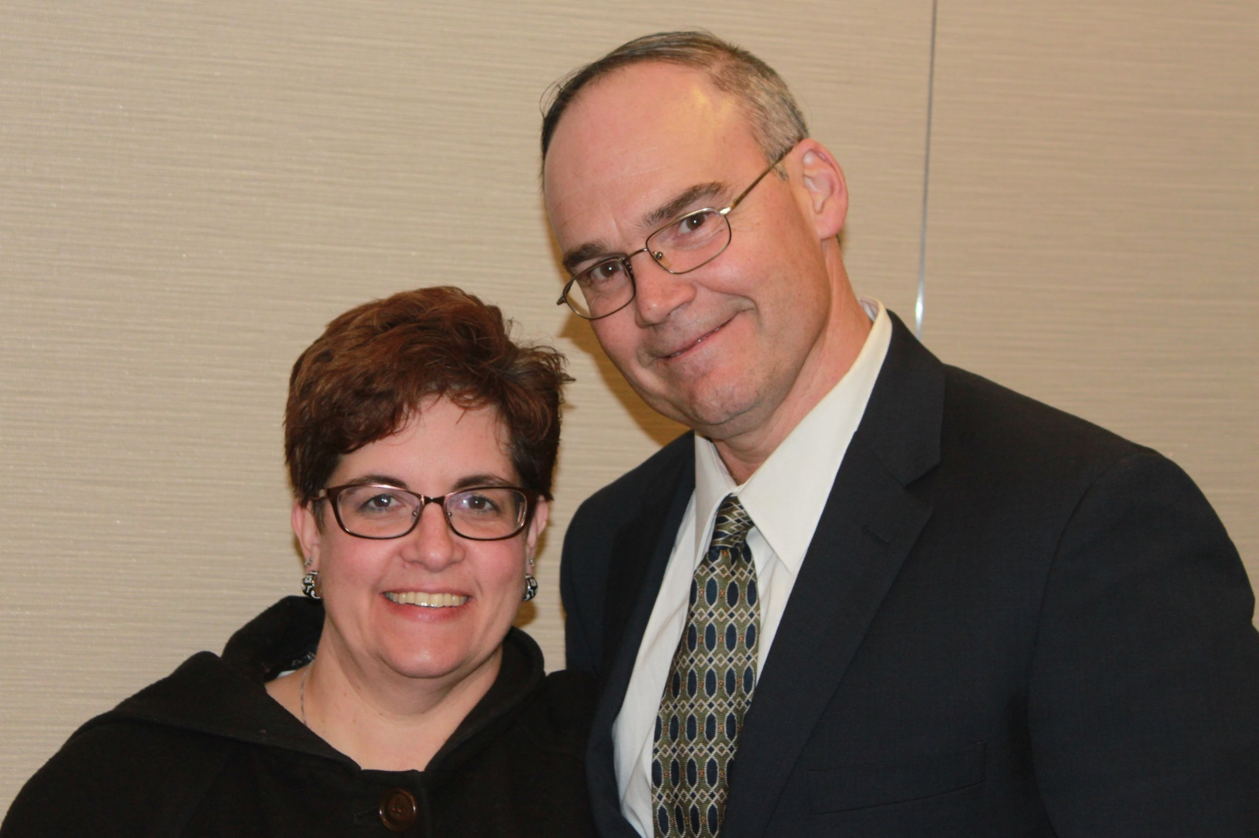
BBSU
December 2017

Slide 48
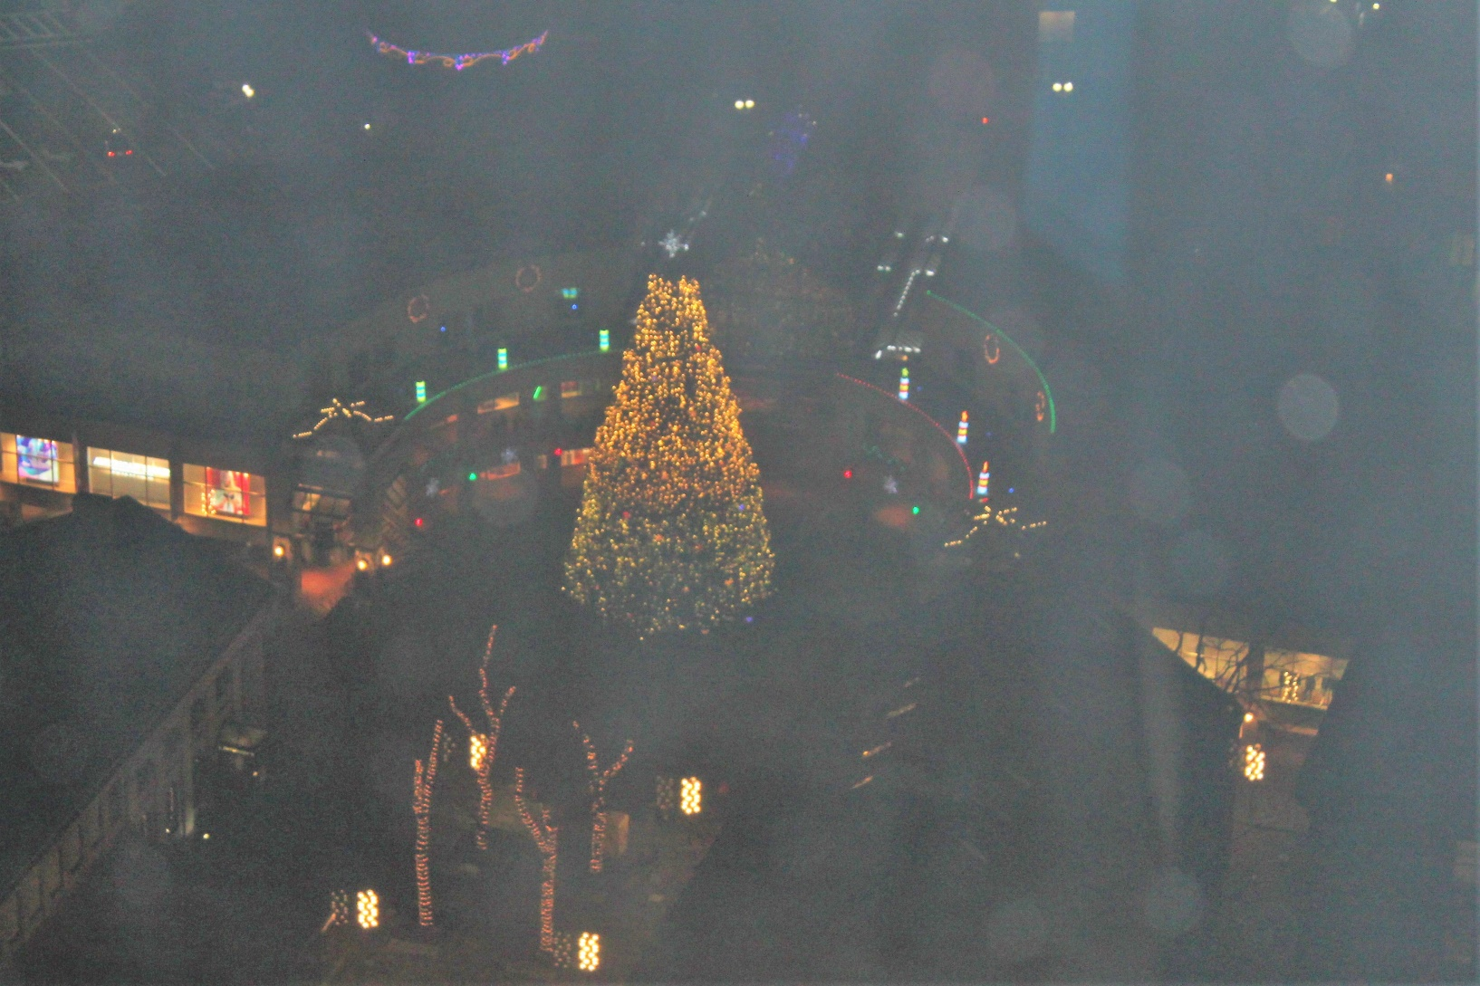
BBSU
December 2017

Slide 49
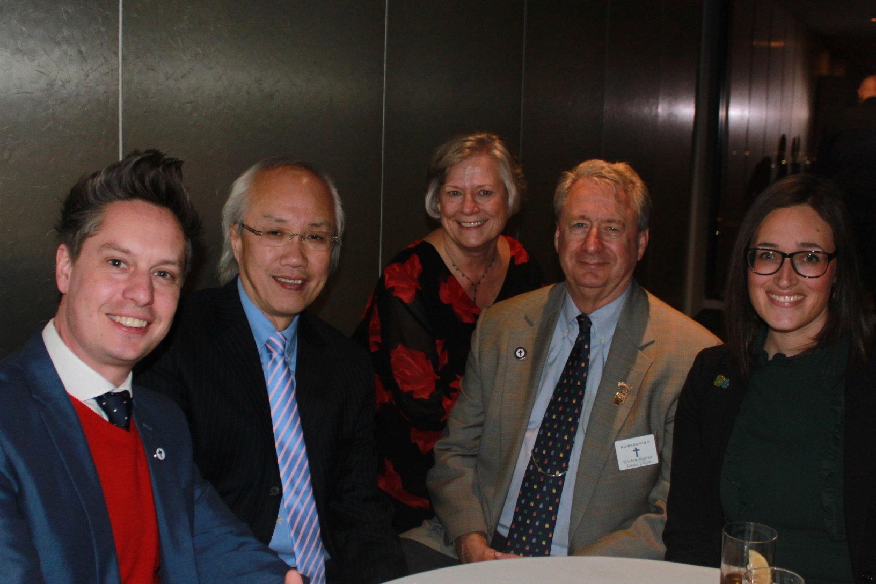
BBSU
December 2017

Slide 50
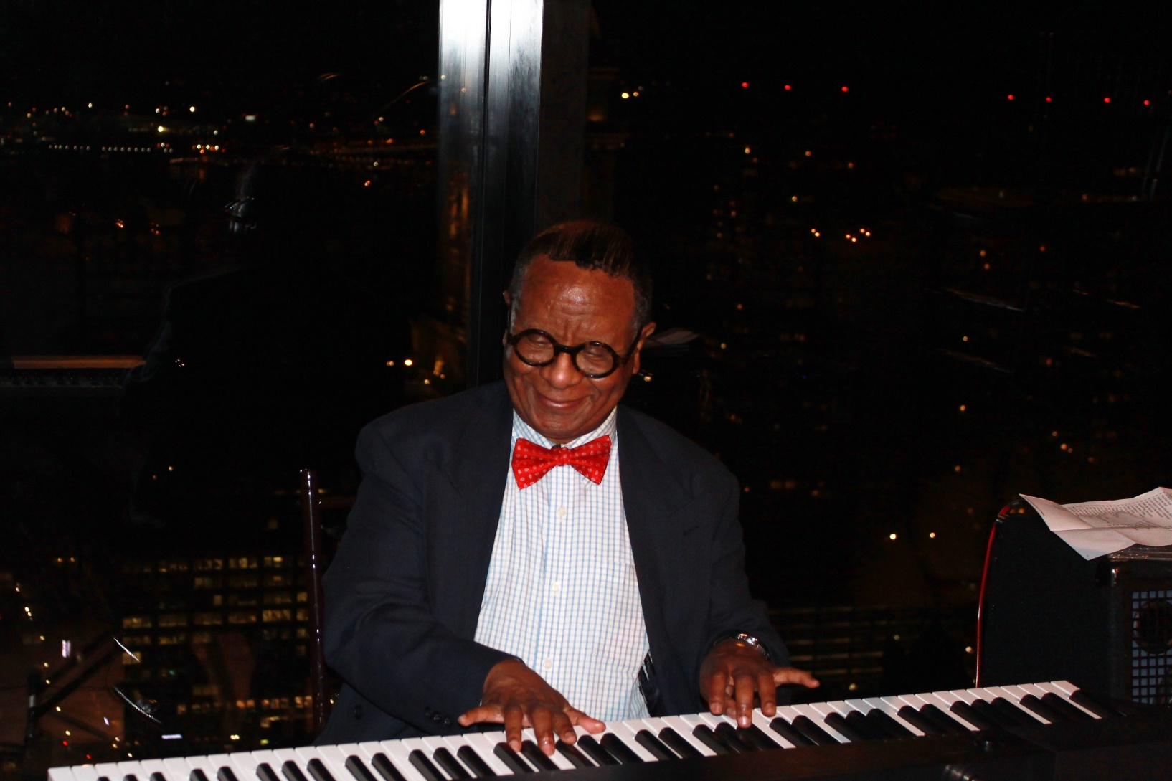
BBSU
December 2017

Slide 51
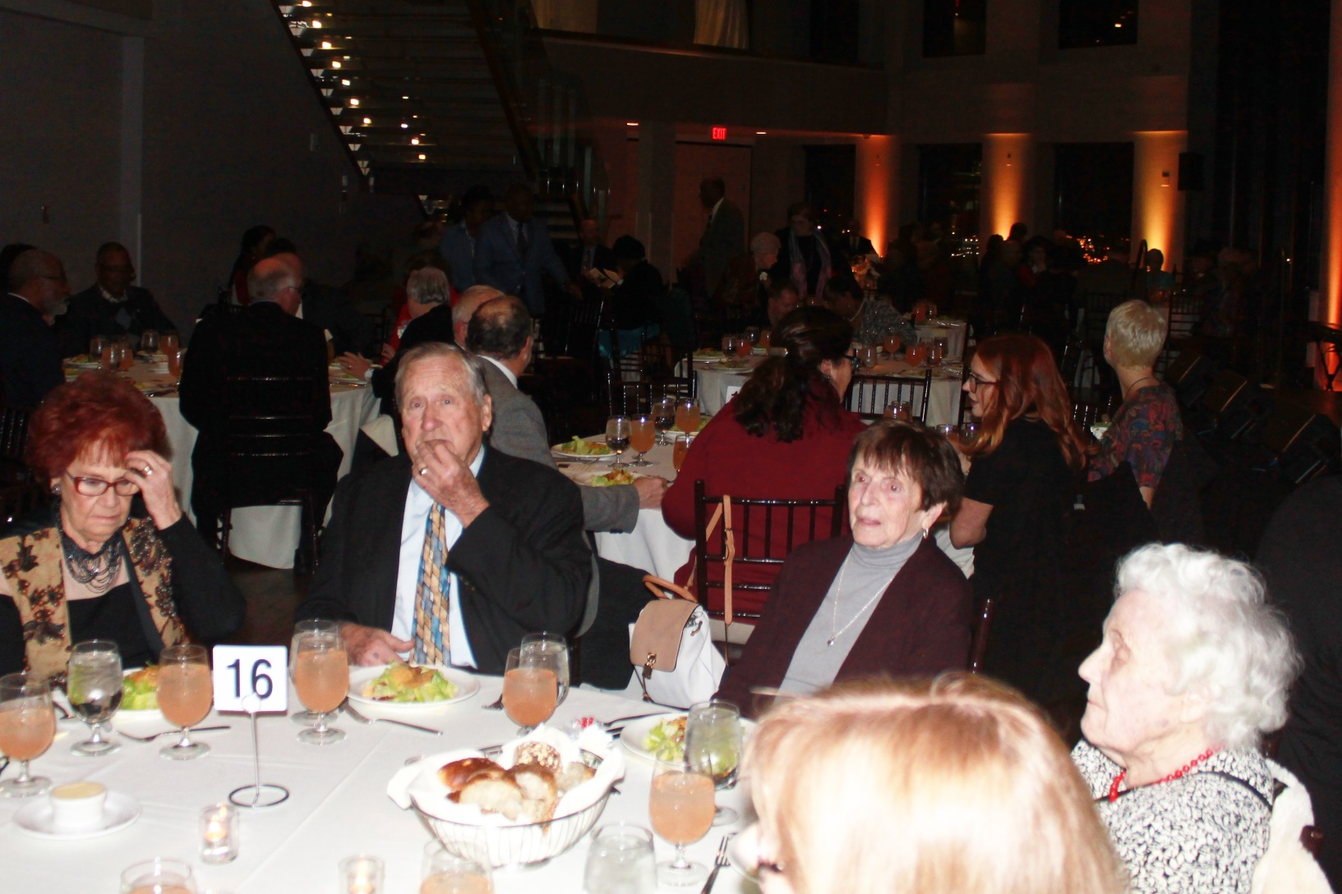
BBSU
December 2017

Slide 52
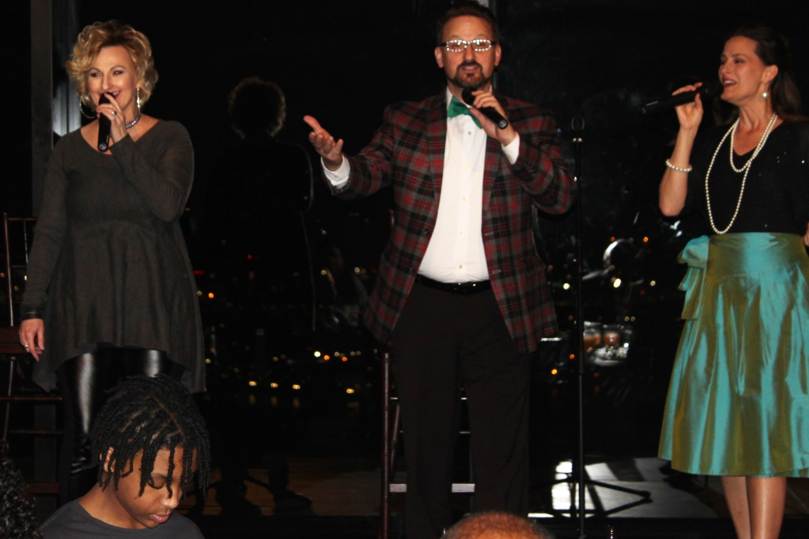
BBSU
December 2017

Slide 53
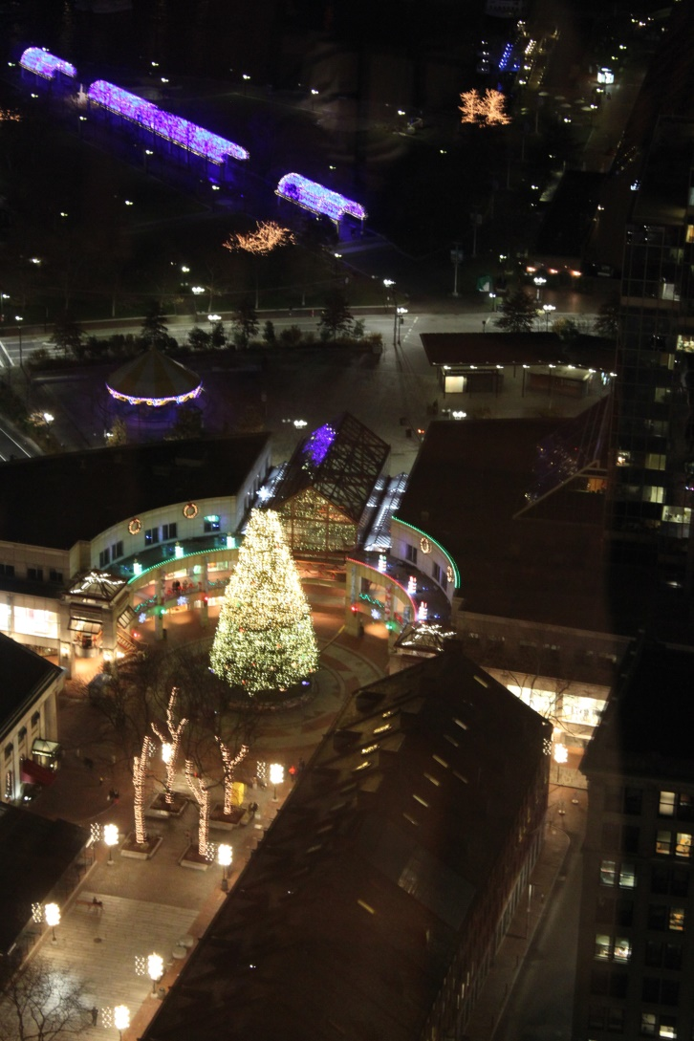
BBSU
December 2017

Slide 54
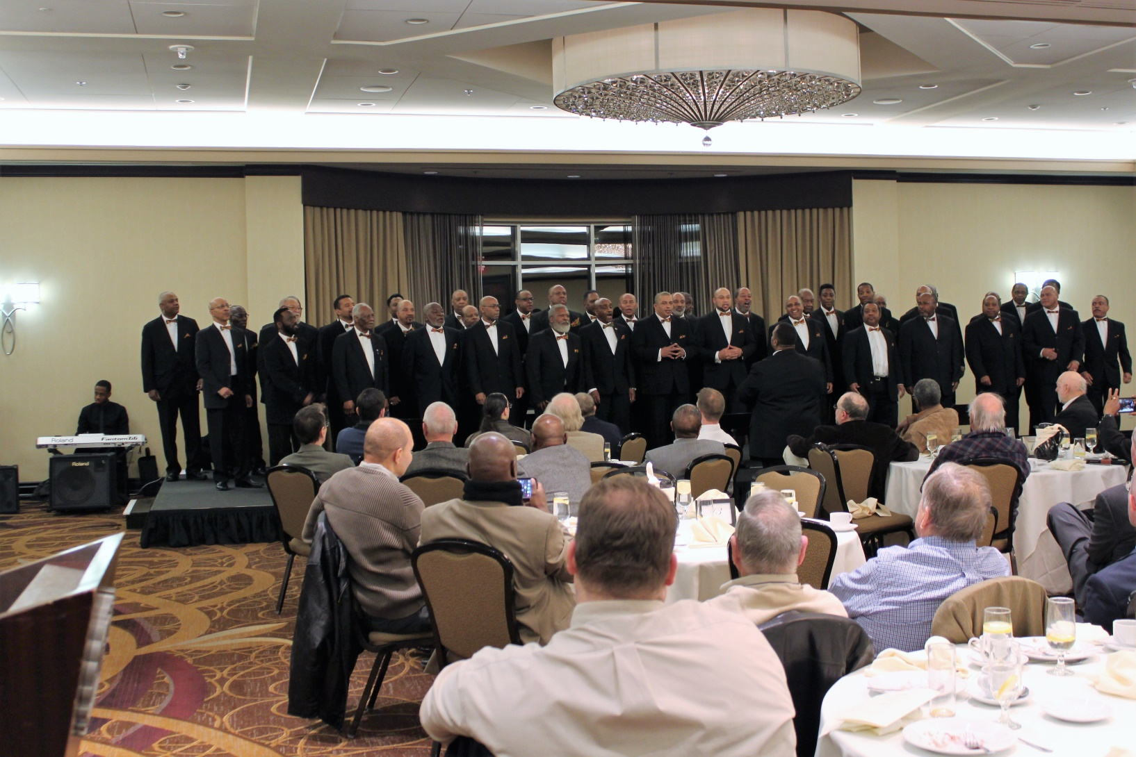
BBSU
February 2016

Slide 55
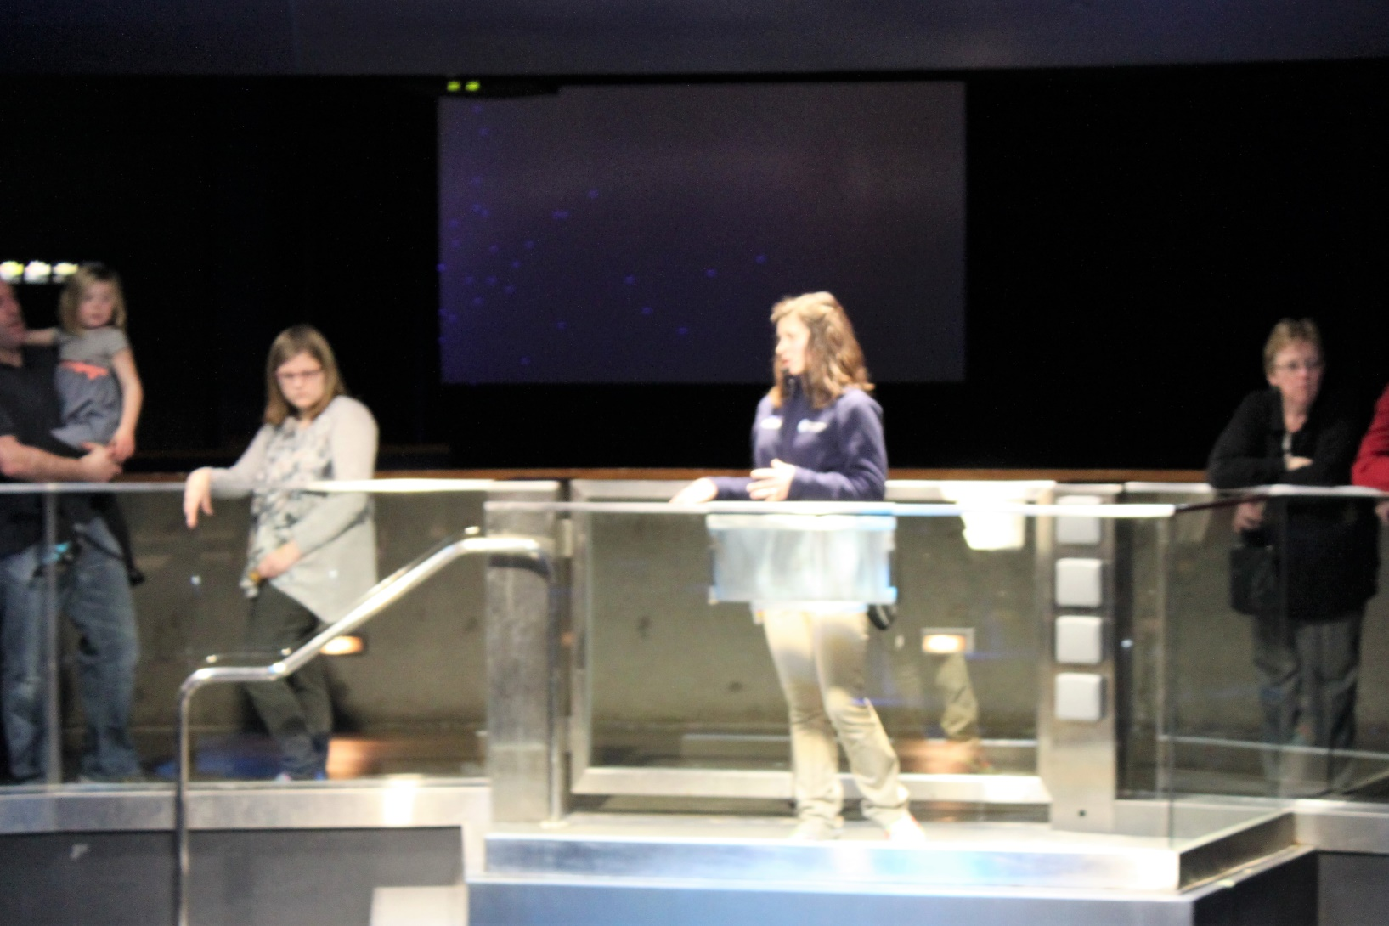
BBSU
March 2016

Slide 56

BBSU
March 2016

Slide 57

BBSU
March 2016

Slide 58

BBSU
March 2016

Slide 59

BBSU
March 2016

Slide 60

BBSU
March 2016

Slide 61

BBSU
March 2016

Slide 62

BBSU
March 2016

Slide 63

BBSU
March 2016

Slide 64

BBSU
April 2016

Slide 65

BBSU
April 2016

Slide 66

BBSU
April 2016

Slide 67

BBSU
April 2016

Slide 68

BBSU
April 2016

Slide 69

BBSU
April 2016

Slide 70

BBSU
April 2016

Slide 71

BBSU
December 2016

Slide 72

BBSU
December 2016

Slide 73

BBSU
December 2016

Slide 74

BBSU
December 2016

Slide 75

BBSU
December 2016

Slide 76

BBSU
December 2016

Slide 77

BBSU
February 2015

Slide 78

BBSU
February 2015

Slide 79

BBSU
March 2015

Slide 80

BBSU
March 2015

Slide 81

BBSU
March 2015

Slide 82

BBSU
March 2015

Slide 83

BBSU
March 2015

Slide 84

BBSU
March 2015

Slide 85

BBSU
March 2015

Slide 86

BBSU
March 2015

Slide 87

BBSU
April 2015

Slide 88

BBSU
April 2015

Slide 89

BBSU
April 2015

Slide 90

BBSU
April 2015

Slide 91

BBSU
April 2015

Slide 92

BBSU
April 2015

